Slide 1
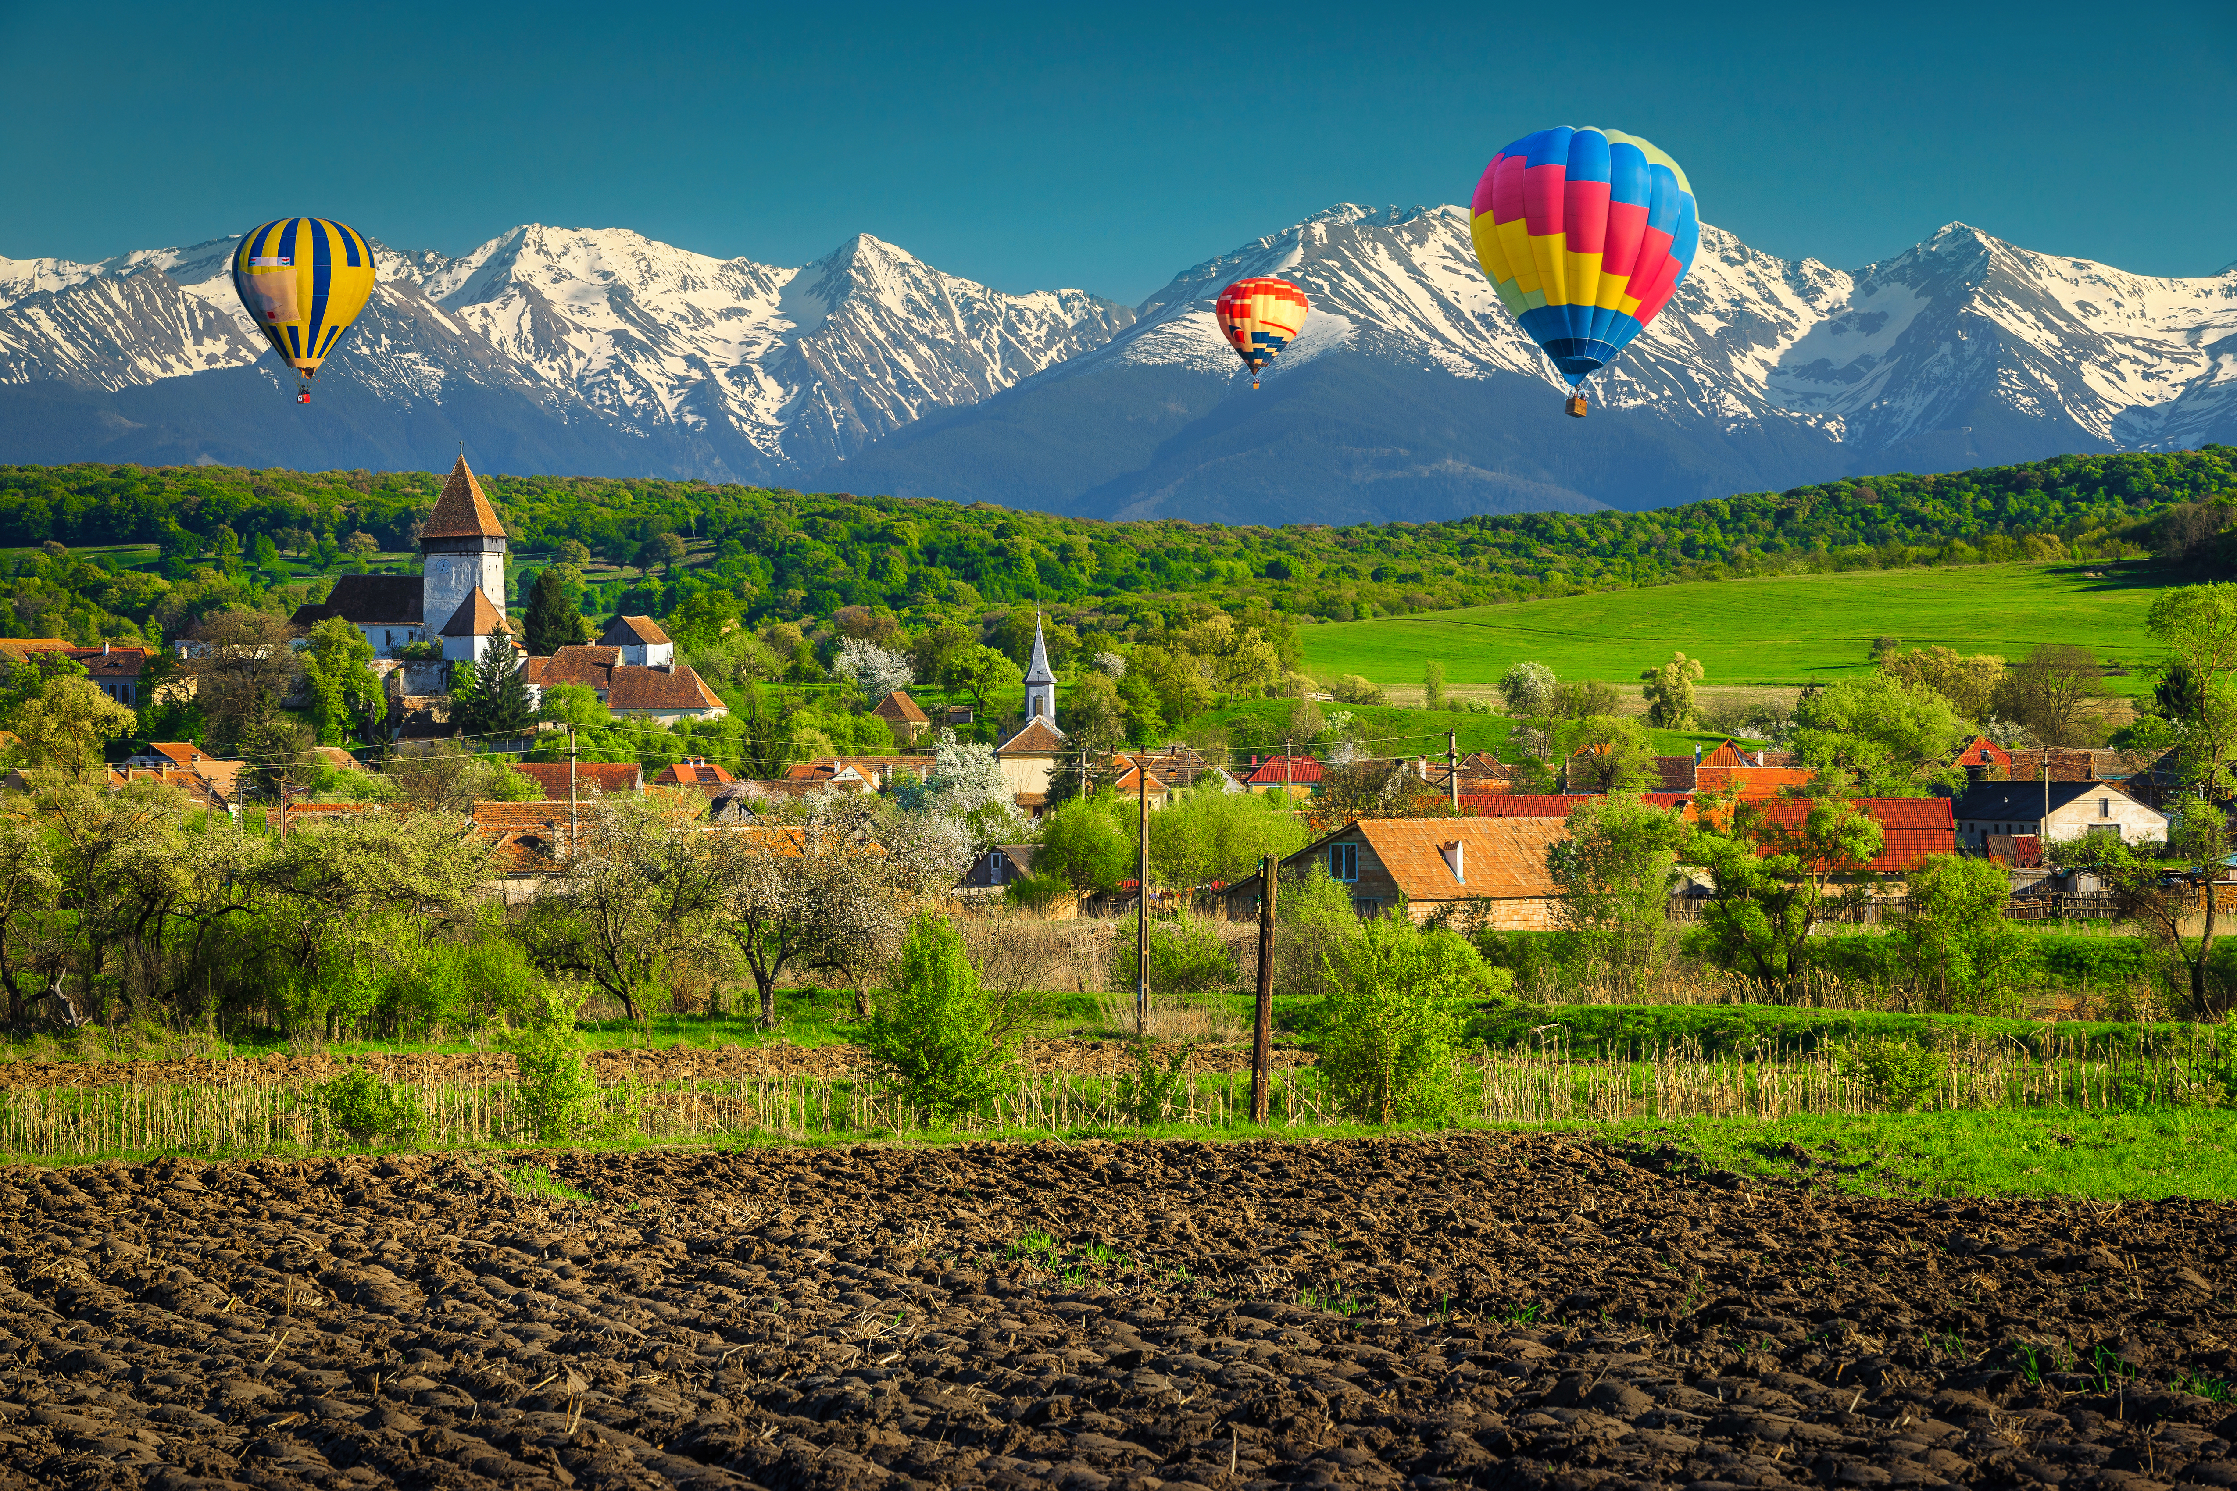
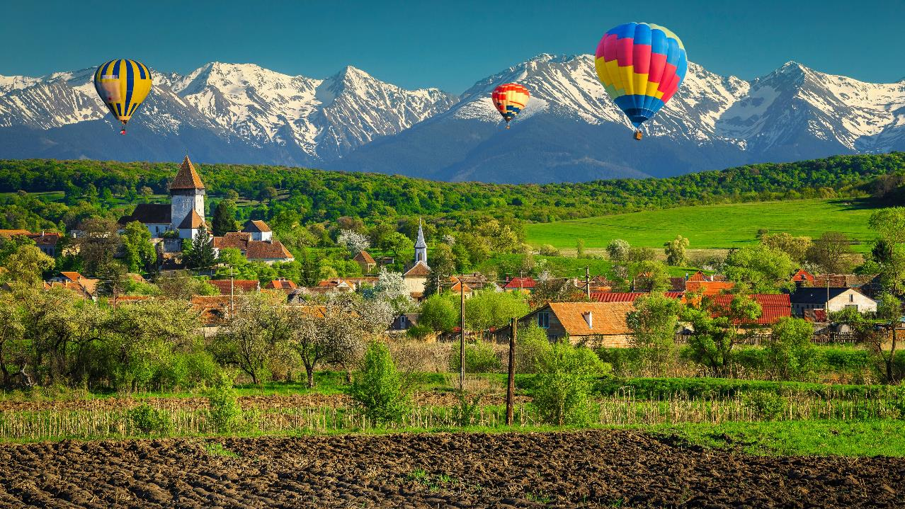

GENERAL PRESENTATION
TEMPLATE
APPLICATION
2025 EDITION
BEST TOURISM VILLAGES BY UN TOURISM

Slide 2
The General Presentation (to be uploaded in Field 3.9. of the Online Application Form) should be a “summary” of the candidacy. This is a good opportunity to stress the most relevant initiatives and highlights of the village, so applicants are invited to make it as visual as possible (use bullet points, relevant pictures, etc.) to showcase the information provided in the Areas of Evaluation (section 4 of the Application Form).
Keep in mind that this template is only a suggestion of how the information to be presented should be structured. Be creative to present the most relevant information in a concrete and orderly way.

Slide 3
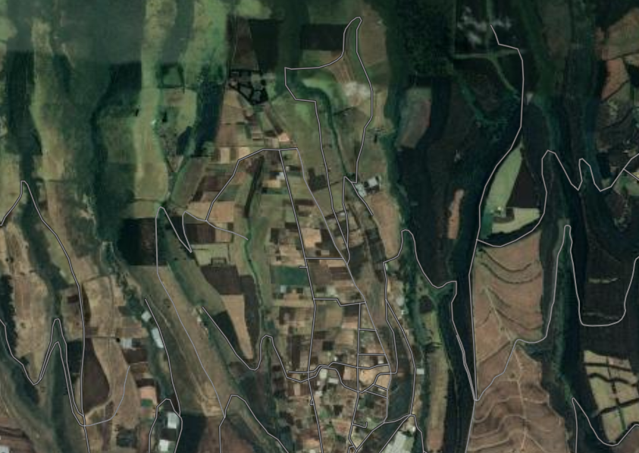

Slide 0: Where is the village and its boundaries
The purpose of this slide is to provide information about the exact location of the village.
If possible, please mark the boundaries of the village . You can refer to the example provided below.
Our village location and boundaries
* Highly recommended to include a scale reference.

Slide 4
Slide 1: Getting to know the village
The purpose of this slide is to provide information of the main aspects of the village as an introductory slide.
Please remember to make it as visual as possible: include relevant pictures that showcase the information provided.

Slide 5
Slide 2: Tell us about the most innovative initiative developed in the village for tourism
The purpose of this slide is to highlight the most innovative initiative developed in the village for tourism.
Please remember to make it as visual as possible: include relevant pictures that showcase the information provided.

Slide 6
Slide 3: AREA 1 - Cultural and Natural Resources
The purpose of this slide is to illustrate the information provided in the section 4. Areas of Evaluation of the Online Application Form related to this area of evaluation.
Please remember to make it as visual as possible: include relevant pictures that showcase the information provided.

Slide 7
Slide 4: AREA 2 - Promotion and Conservation of Cultural Resources
The purpose of this slide is to illustrate the information provided in the section 4. Areas of Evaluation of the Online Application Form related to this area of evaluation.
Please remember to make it as visual as possible: include relevant pictures that showcase the information provided.

Slide 8
Slide 5: AREA 3 - Economic Sustainability
The purpose of this slide is to illustrate the information provided in the section 4. Areas of Evaluation of the Online Application Form related to this area of evaluation.
Please remember to make it as visual as possible: include relevant pictures that showcase the information provided.

Slide 9
Slide 6: AREA 4 - Social Sustainability
The purpose of this slide is to illustrate the information provided in the section 4. Areas of Evaluation of the Online Application Form related to this area of evaluation.
Please remember to make it as visual as possible: include relevant pictures that showcase the information provided.

Slide 10
Slide 7: AREA 5 - Environmental Sustainability
The purpose of this slide is to illustrate the information provided in the section 4. Areas of Evaluation of the Online Application Form related to this area of evaluation.
Please remember to make it as visual as possible: include relevant pictures that showcase the information provided.

Slide 11
Slide 8: AREA 6 - Tourism Development and Value Chain Integration
The purpose of this slide is to illustrate the information provided in the section 4. Areas of Evaluation of the Online Application Form related to this area of evaluation.
Please remember to make it as visual as possible: include relevant pictures that showcase the information provided.

Slide 12
Slide 9: AREA 7 - Governance and prioritization of tourism
The purpose of this slide is to illustrate the information provided in the section 4. Areas of Evaluation of the Online Application Form related to this area of evaluation.
Please remember to make it as visual as possible: include relevant pictures that showcase the information provided.

Slide 13
Slide 10: AREA 8 - Infrastructure and connectivity
The purpose of this slide is to illustrate the information provided in the section 4. Areas of Evaluation of the Online Application Form related to this area of evaluation.
Please remember to make it as visual as possible: include relevant pictures that showcase the information provided.

Slide 14
Slide 11: AREA 9 - Health, Safety and Security
The purpose of this slide is to illustrate the information provided in the section 4. Areas of Evaluation of the Online Application Form related to this area of evaluation.
Please remember to make it as visual as possible: include relevant pictures that showcase the information provided.

