Slide 1
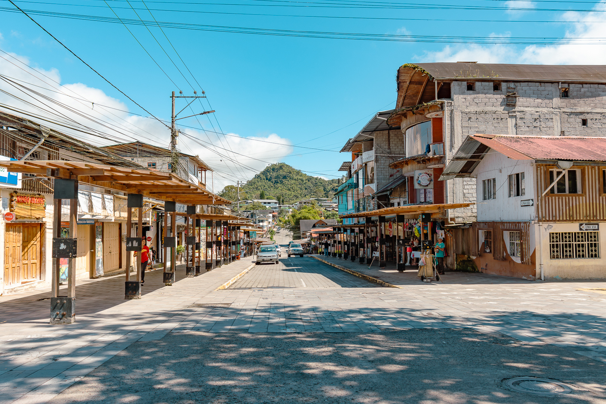
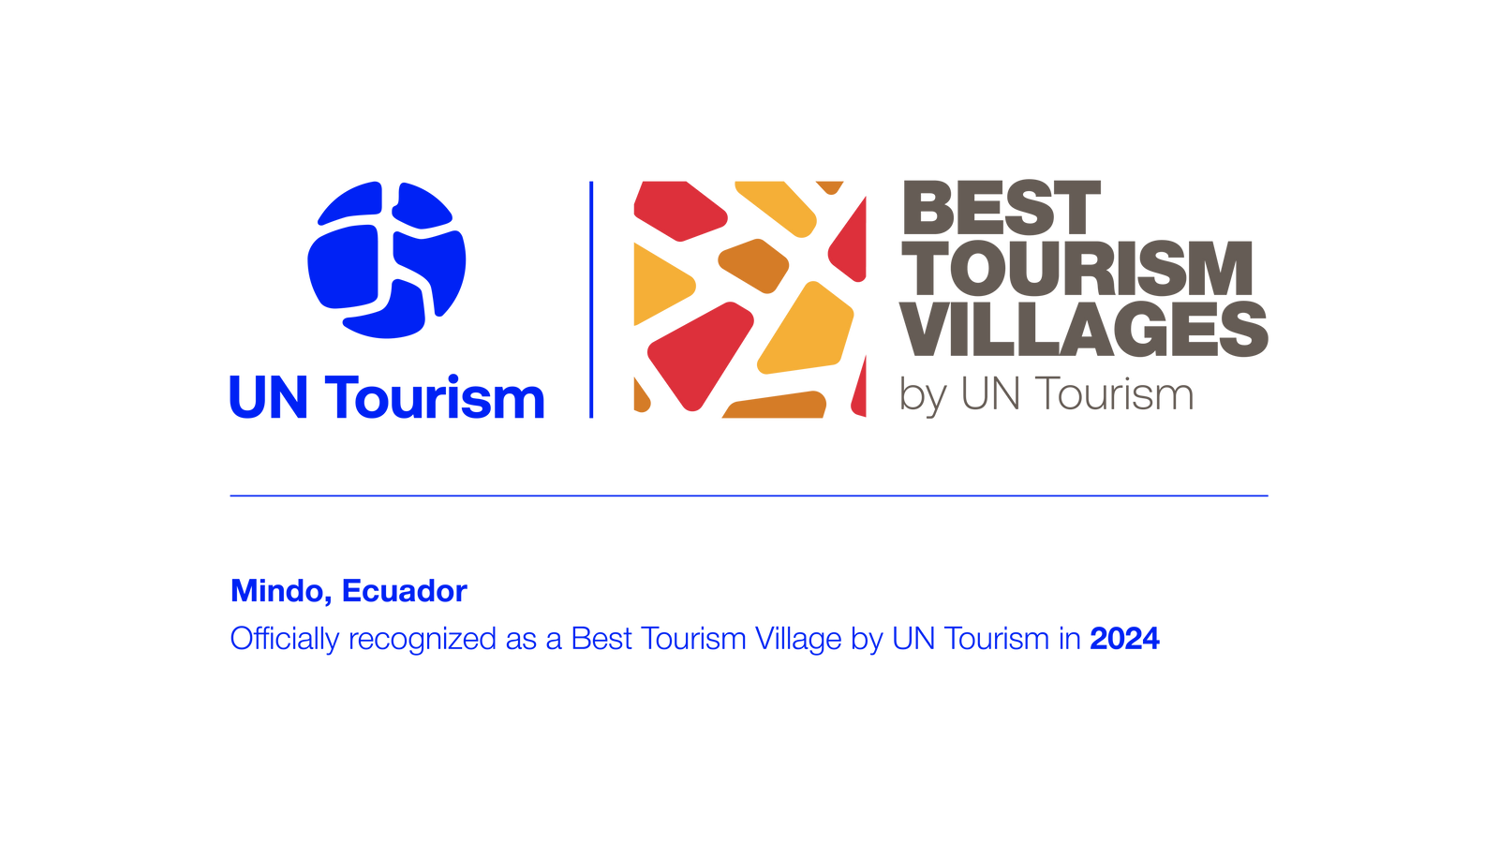
Tourism
Conservation
Nature
Aaventure
MINDO
-
gobiernoparroquialmindo@hotmail.com
www.mindo.gob.ec

Slide 2
Disclaimer
This presentation was developed by an external party to UN Tourism and was delivered during the Best Tourism Villages by UN Tourism Network Village Talks online session titled: “Tourism for Nature: Conserving Natural Resources through Sustainable Rural Development”, held on July 31, 2025.
The designations employed and the presentation of material in this publication do not imply the expression of any opinions whatsoever on the part of the Secretariat of UN Tourism concerning the legal status of any country, territory, city or area, or of its authorities or concerning the delimitation of its frontiers or boundaries.
UN Tourism does not guarantee the accuracy of the data included in this publication and accepts no responsibility for any consequence of their use.
The mention of specific companies or products of manufacturers does not imply that they are endorsed or recommended by UN Tourism in preference to others of a similar nature that are not mentioned.

Slide 3
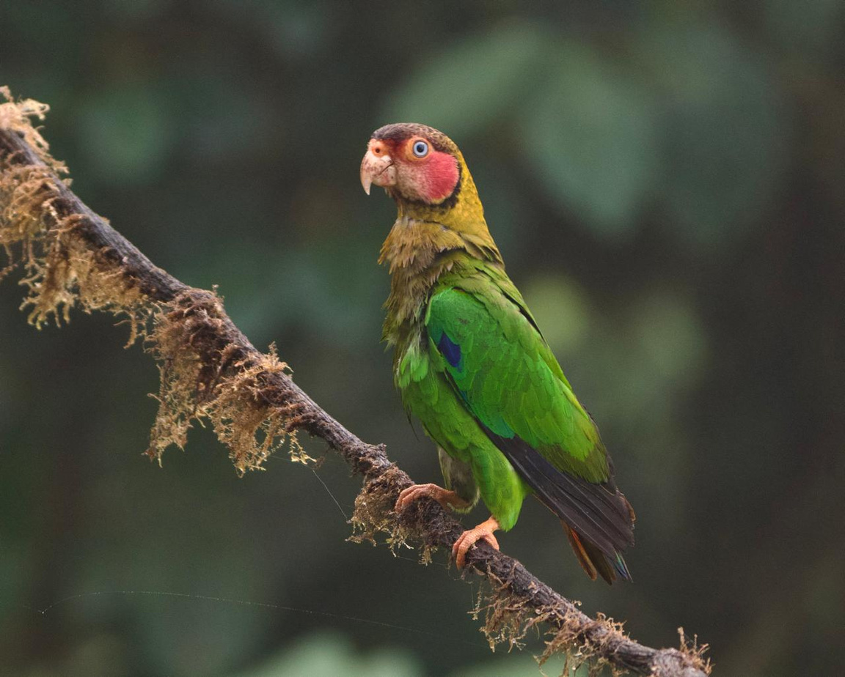
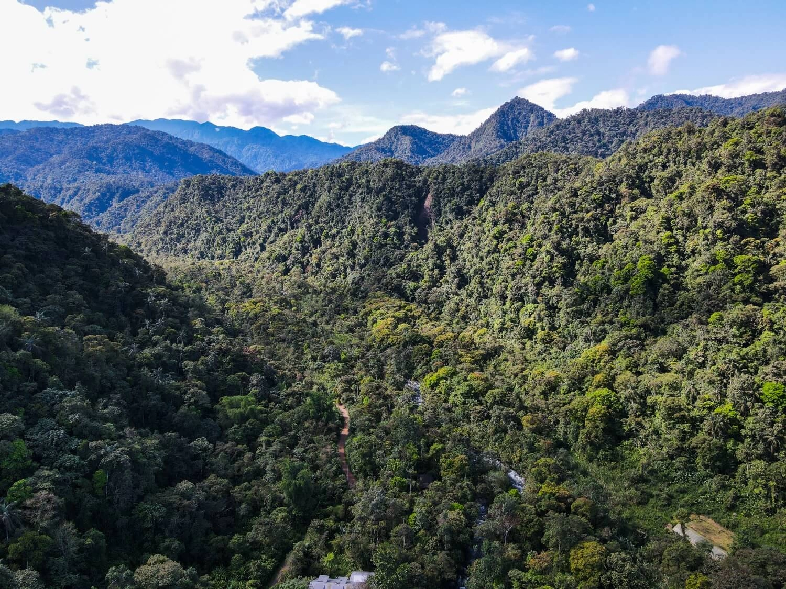
MINDO IS YOUR DESTINATION
INTRODUCTION
Mindo is located in the northwest of the province of Pichincha, 80 km from Quito, the capital of Ecuador.
At an altitude of 1,200 meters above sea level, it is known for its rich biodiversity and natural beauty, which is why Mindo has received several national and international recognitions.
We are the protectors of approximately 19,000 hectares of the Mindo Nambillo Protective Forest, home to more than 500 species of birds, 90 species of butterflies, and more than 170 species of orchids.

Slide 4
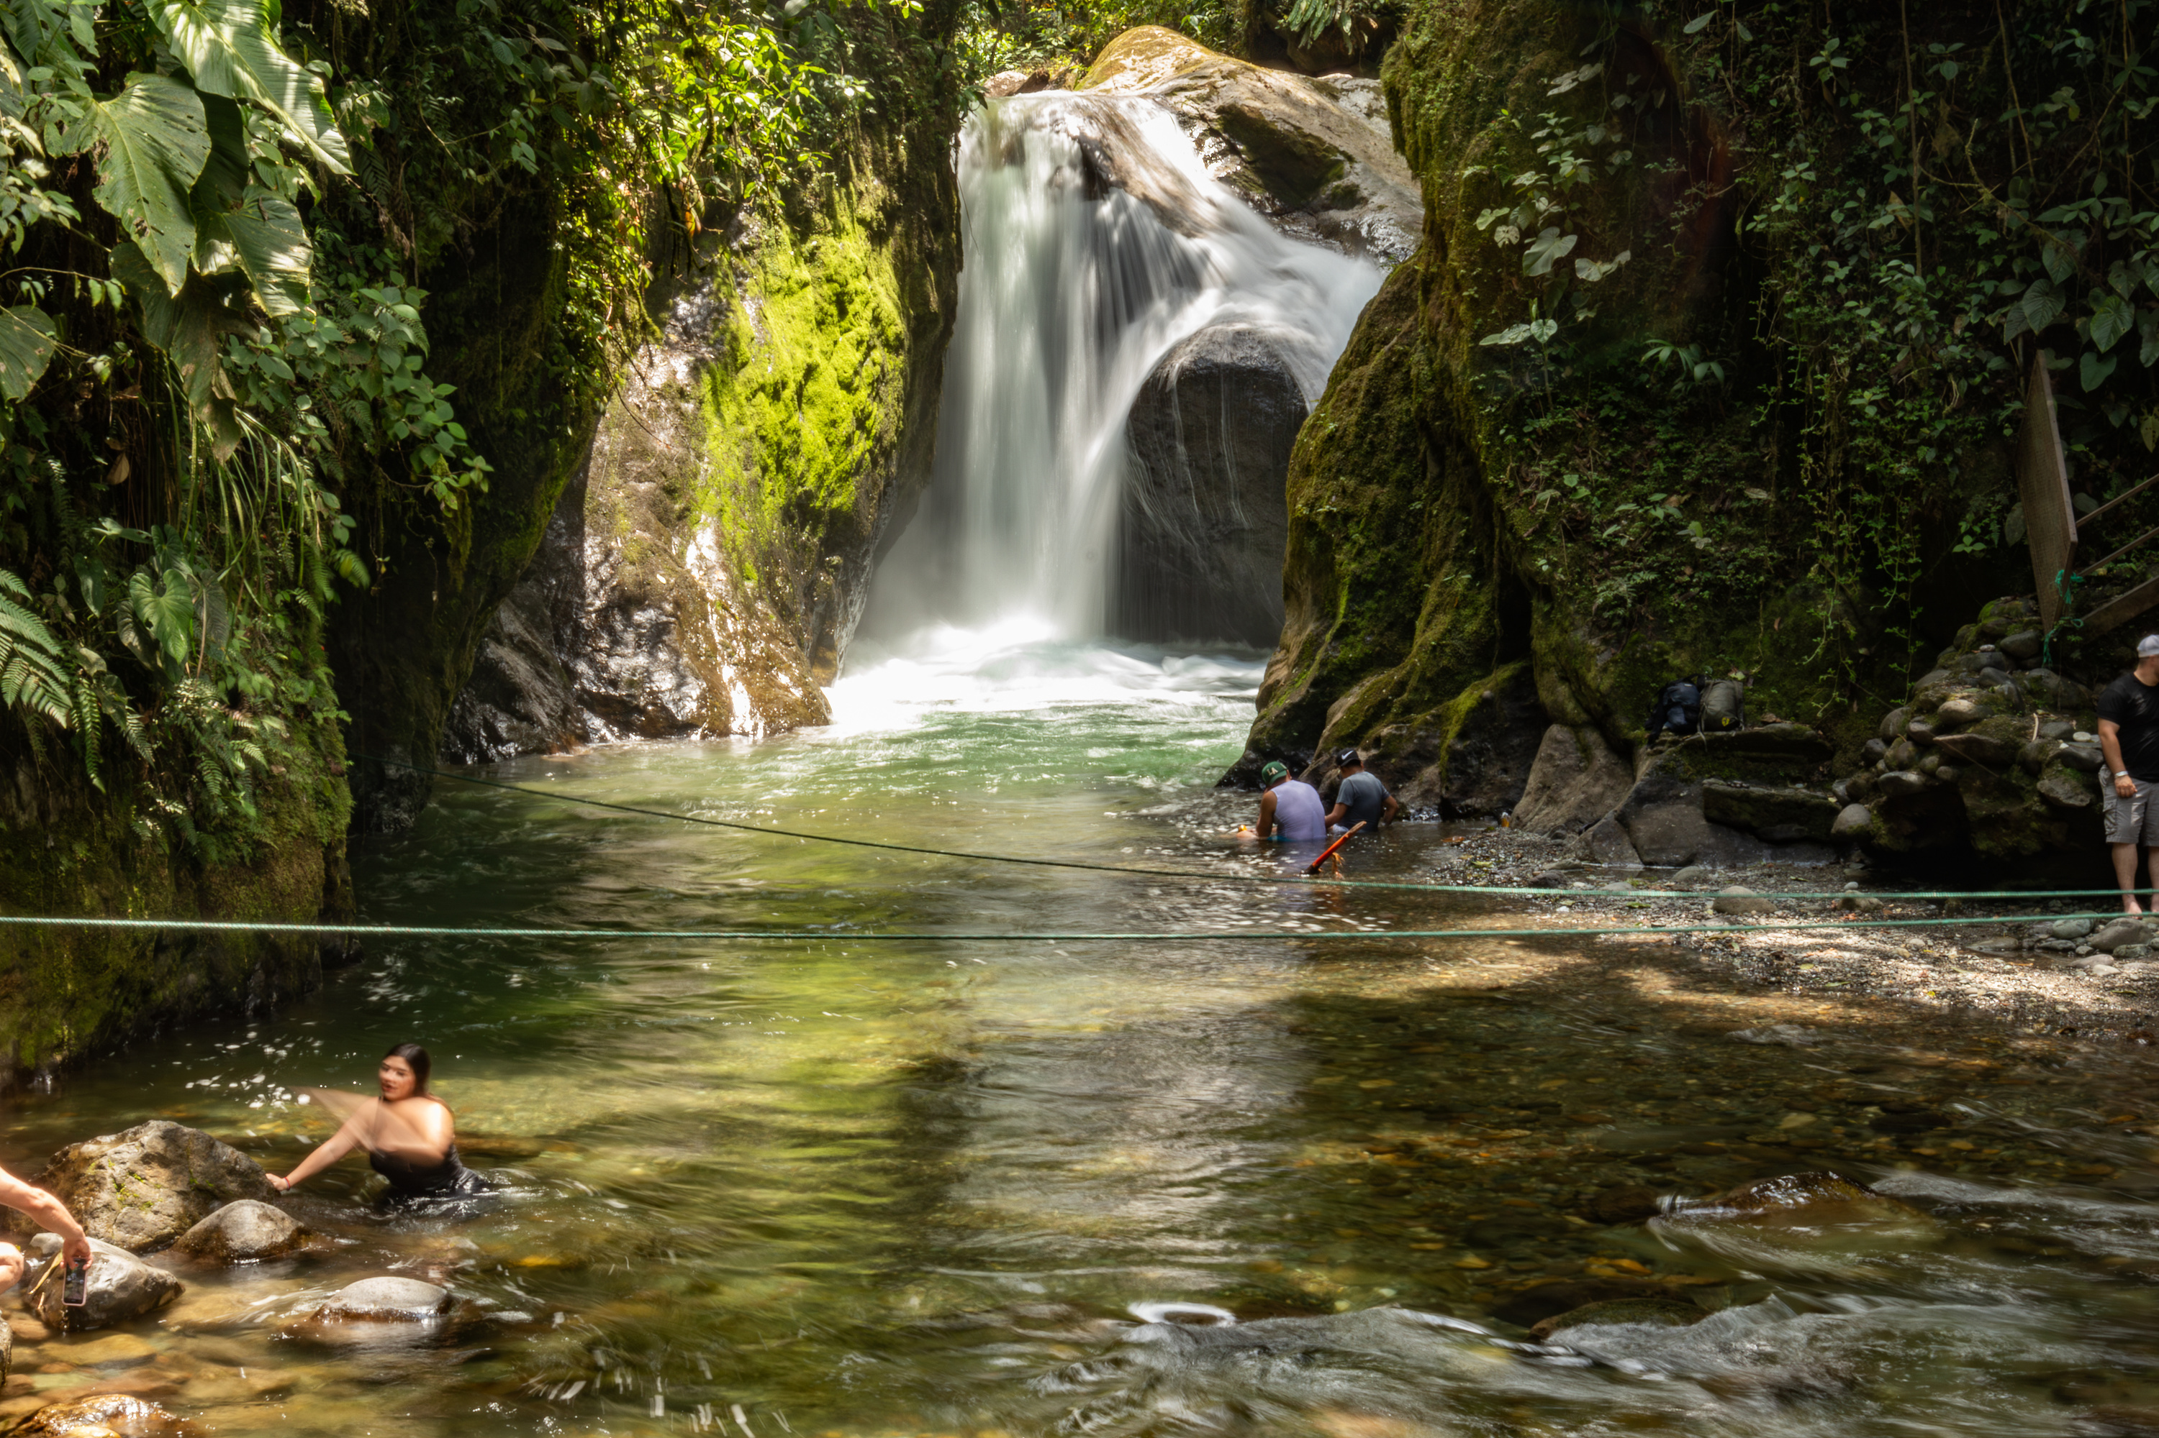


MINDO
Best Tourism Village
Why is this recognition important for the Mindo community?
This recognition positions Mindo as a world leader in sustainable rural tourism.
Being recognized as a Best Tourism Village validates and highlights decades of work by the community, reserves, guides, and local stakeholders.
It increases the interest of national and international tourists in visiting Mindo, which generates economic opportunities for the community.
Beyond being an achievement, this recognition is also a commitment to continue working collectively to protect the Andean Chocó and strengthen tourism that respects and values life.

Slide 5
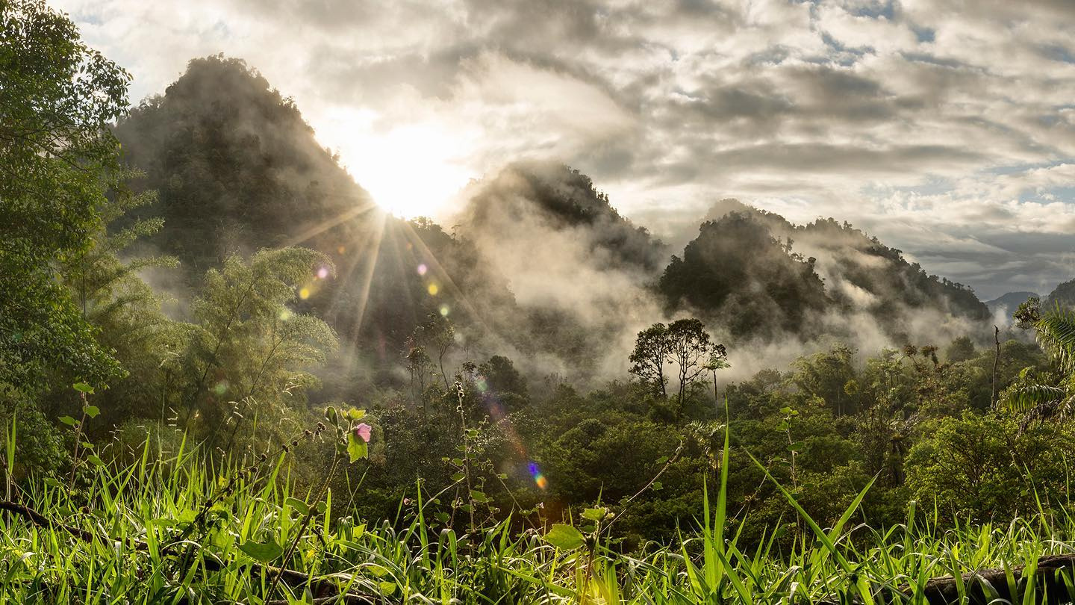
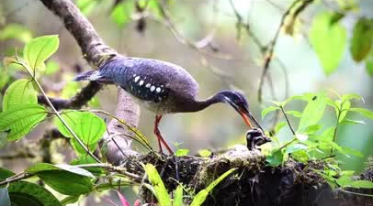
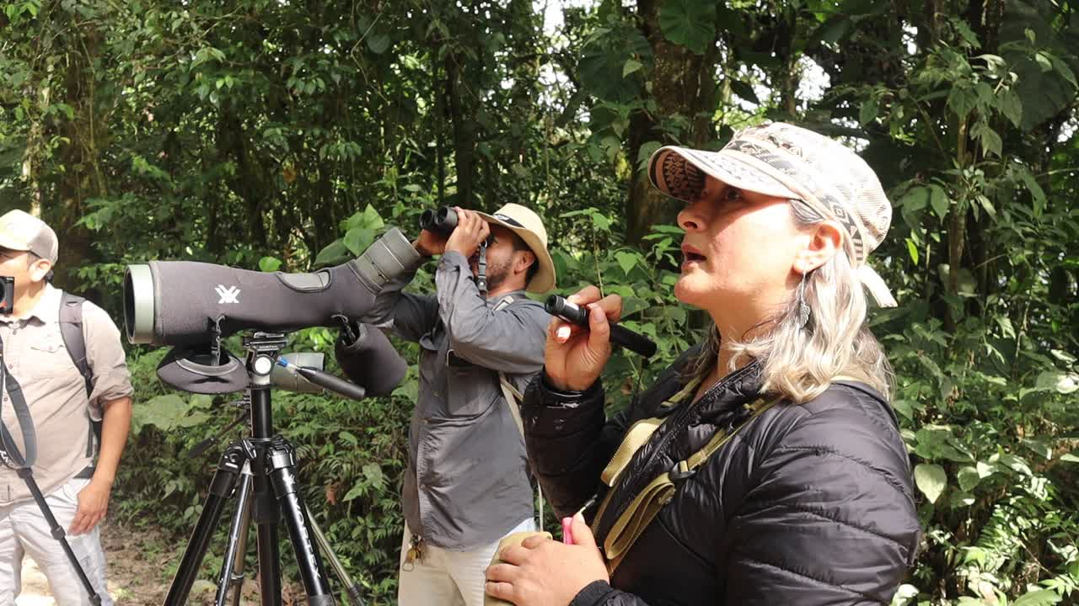
Birdwatching tourism in Mindo has proven to be a low-impact tourism option.
The economic value of the living forest to the community discourages deforestation and encourages its protection.
Interpretive walks within the forest promote environmental education among visitors and residents.
Mindo leverages birdwatching and cloud forest tourism to support the conservation of the Chocó Andino ecosystem.

Slide 6
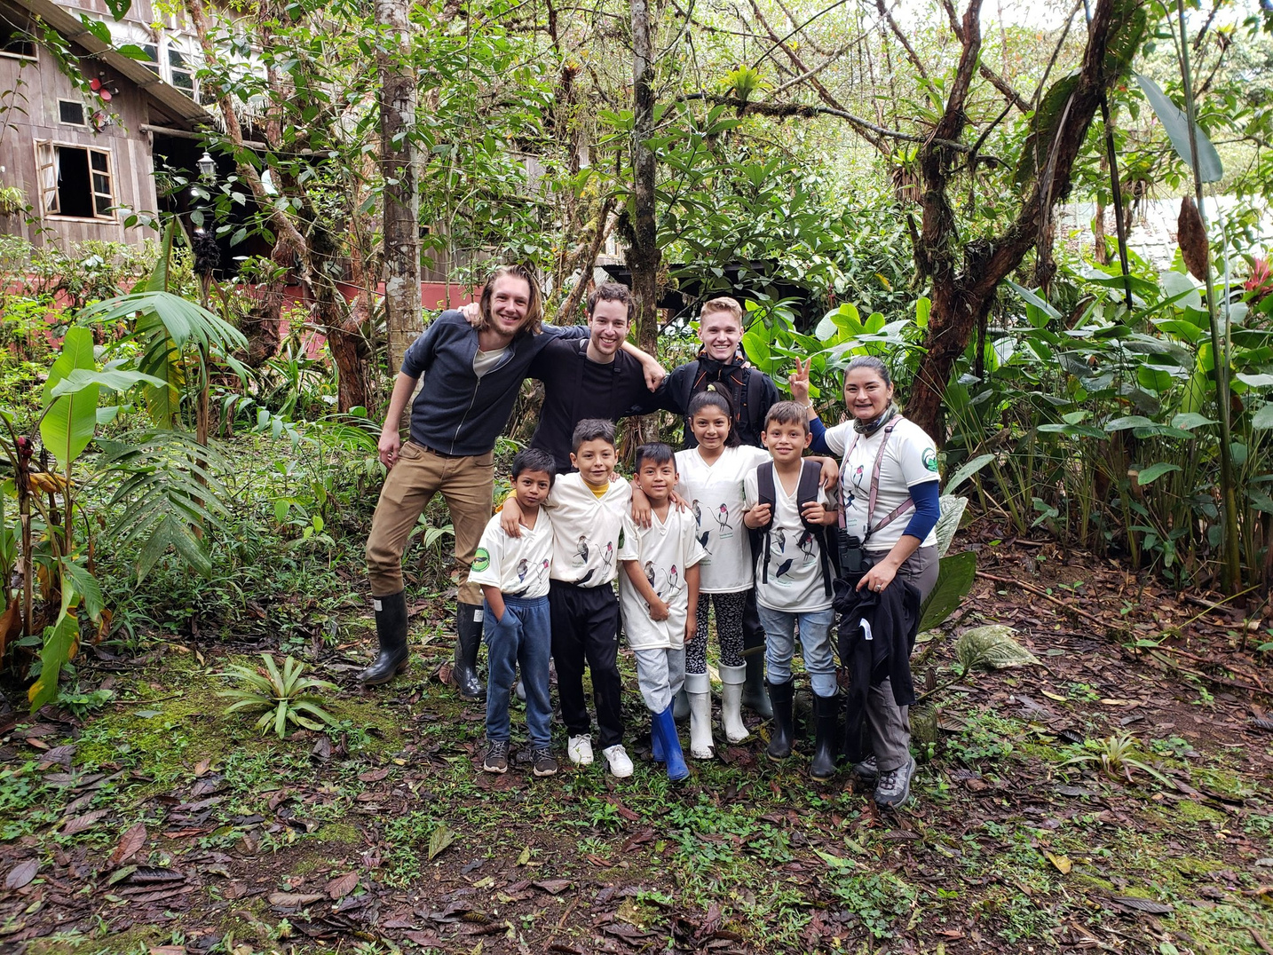
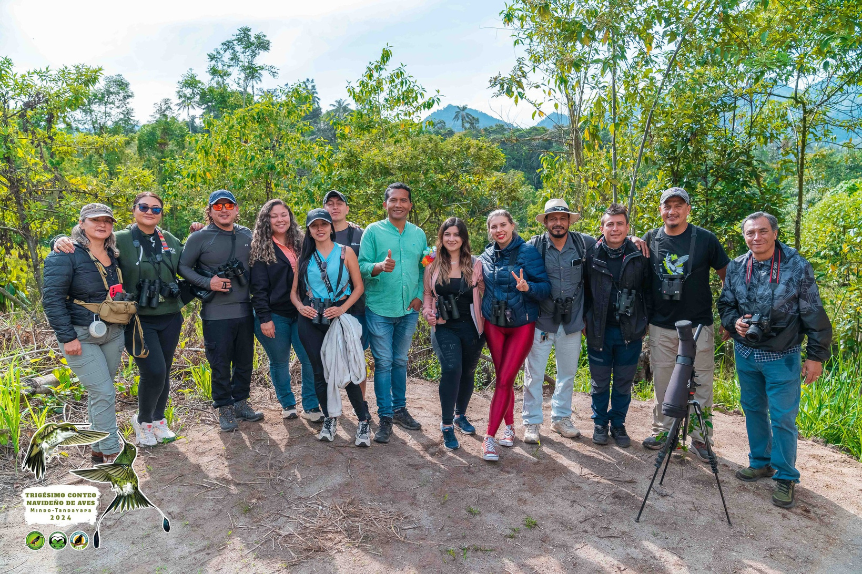
The role of community guides, private reserves, and environmental education in raising awareness
Local guides: They are the link between visitors and nature. They not only demonstrate the forest's biodiversity but also share knowledge about the ecological value of the territory and the threats it faces. In the past, many of them were hunters and sawyers; today, they are defenders of nature.
Private Reserves: They conserve hundreds of hectares of primary and secondary forest, reforest, protect water sources, and function as biological corridors and wildlife refuges.
Environmental Education: In educational centers, community spaces, and associations, awareness is raised from an early age about the importance of water, forests, fauna, and flora.

Slide 7
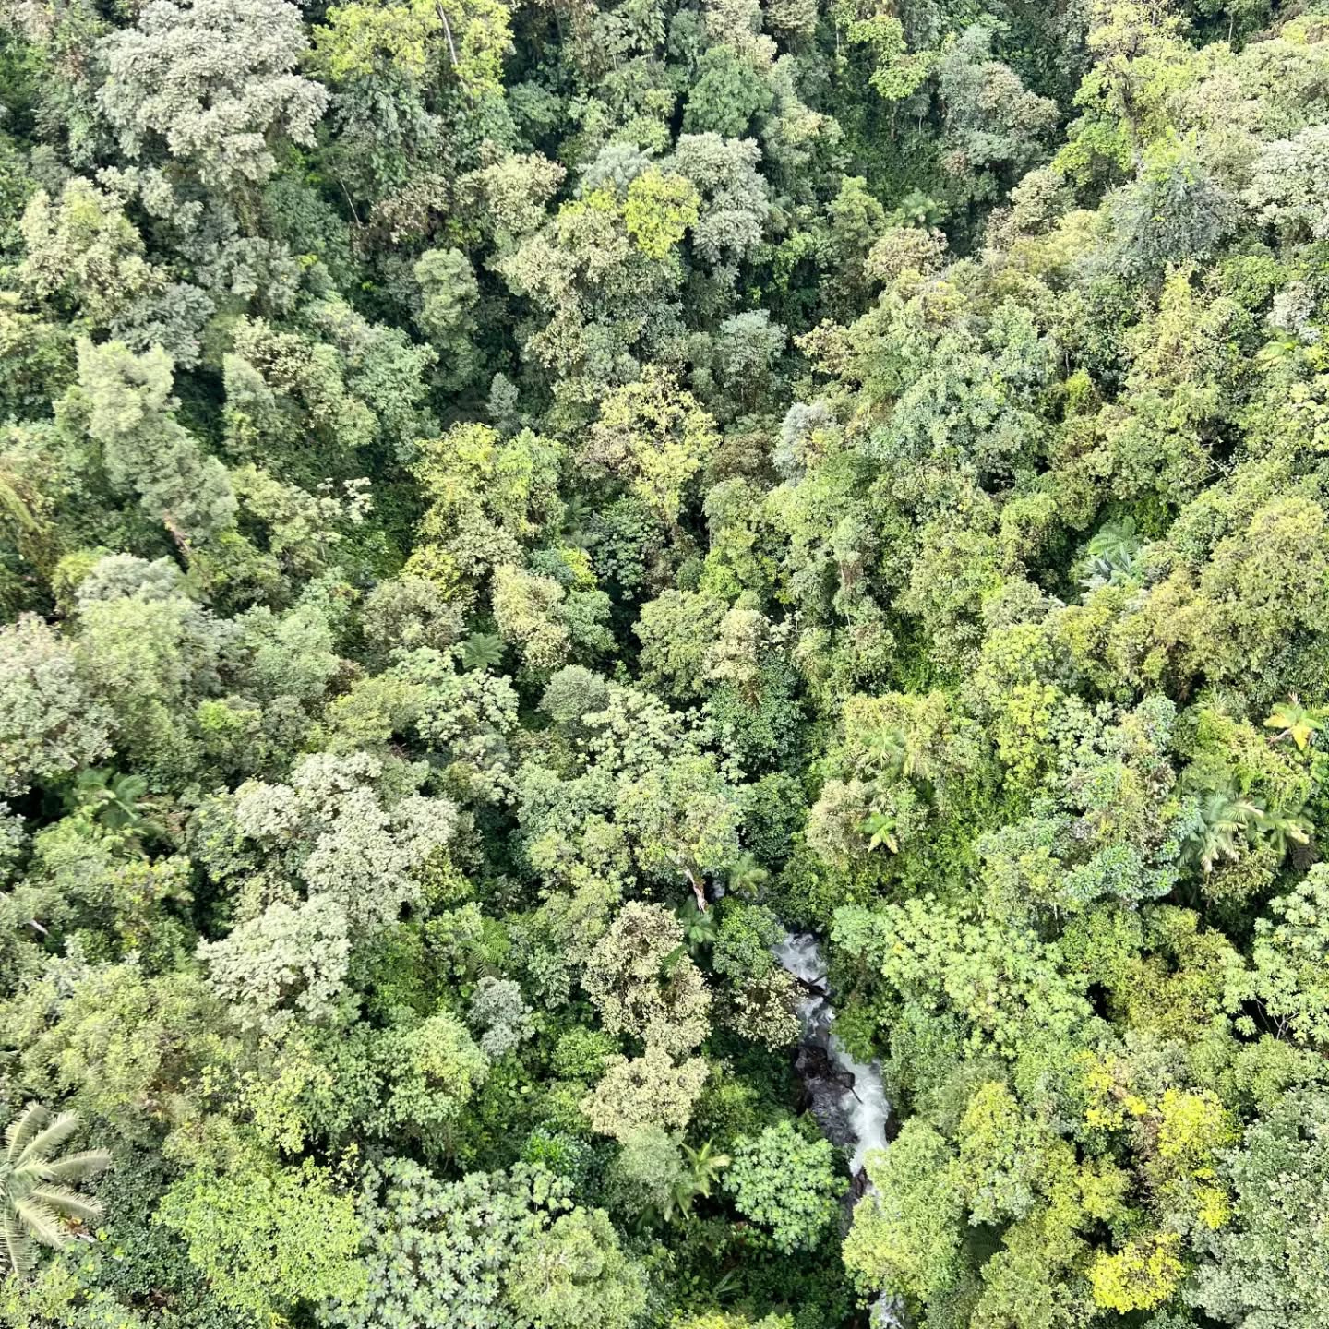
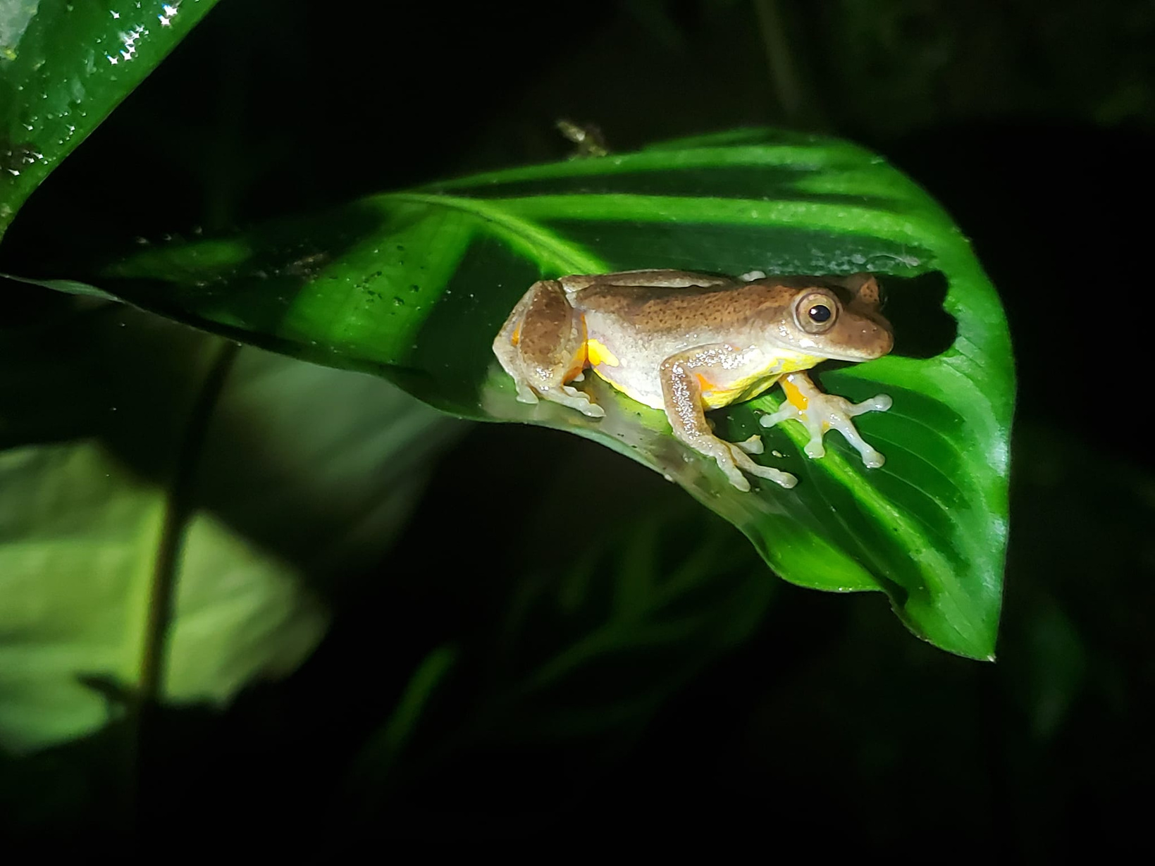
Tourism revenue supports local forest protection and biodiversity initiatives.
Tourism creates sources of income for nature guides, local entrepreneurs, and tour operators who, in turn, become allies in conservation.
Maintenance of nature reserves for the protection of the forest and its biodiversity.
Transition to green business by implementing good environmental practices

Slide 8
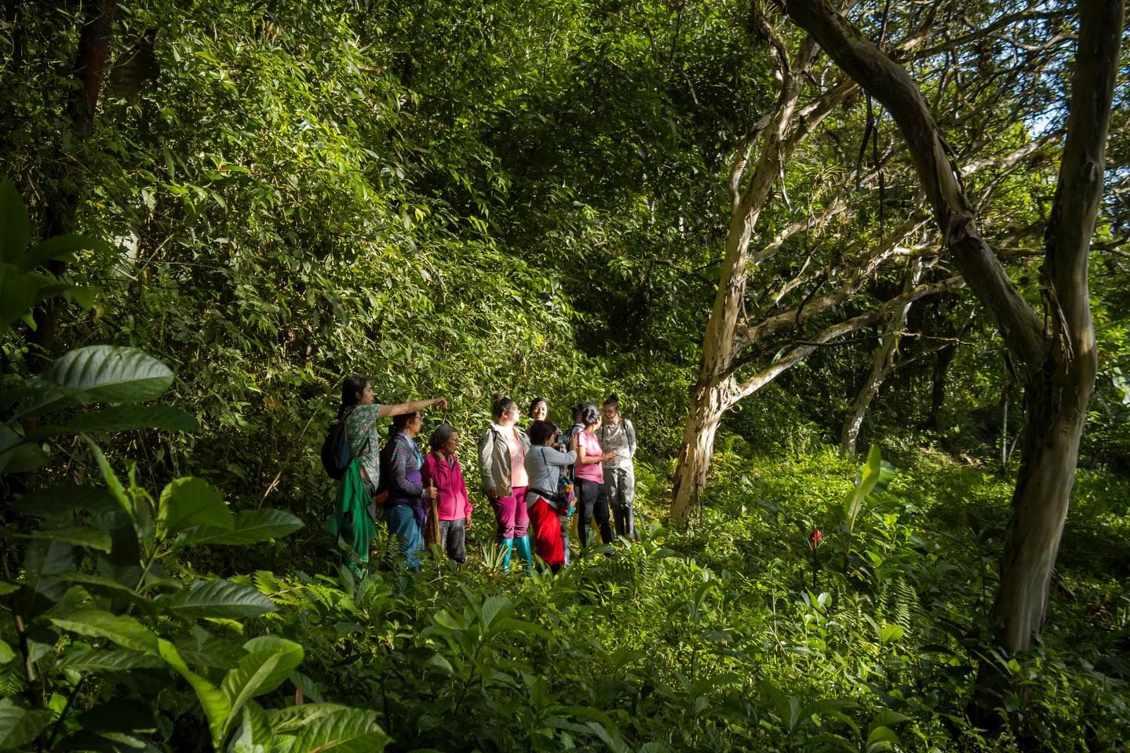
Tourism management to avoid pressure on fragile ecosystems
An eco-tourism model that attracts visitors interested in biodiversity and sustainable experiences.
Private reserves offer controlled trails and guided tours to prevent uncontrolled entry and minimize human impact.
Best practices in tourism developments.
Access and activity regulations have been implemented, with visitor limits, controlled hours, and rules of conduct.

Slide 9
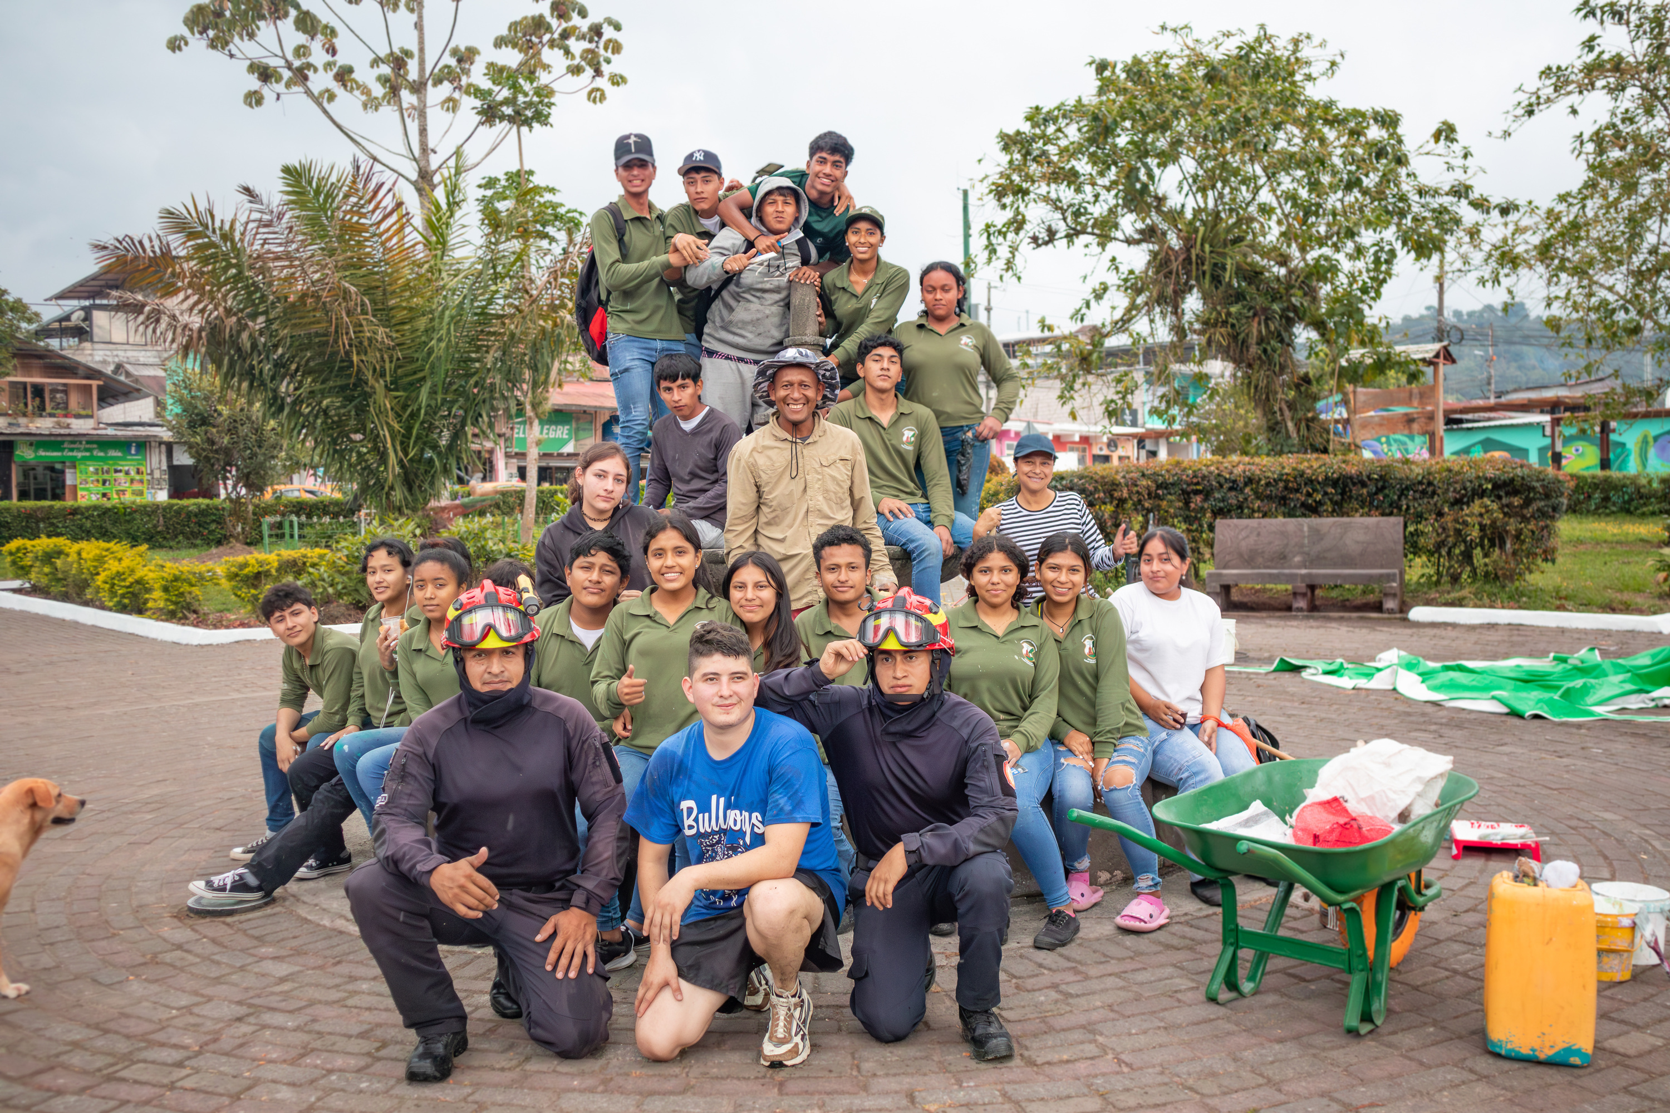
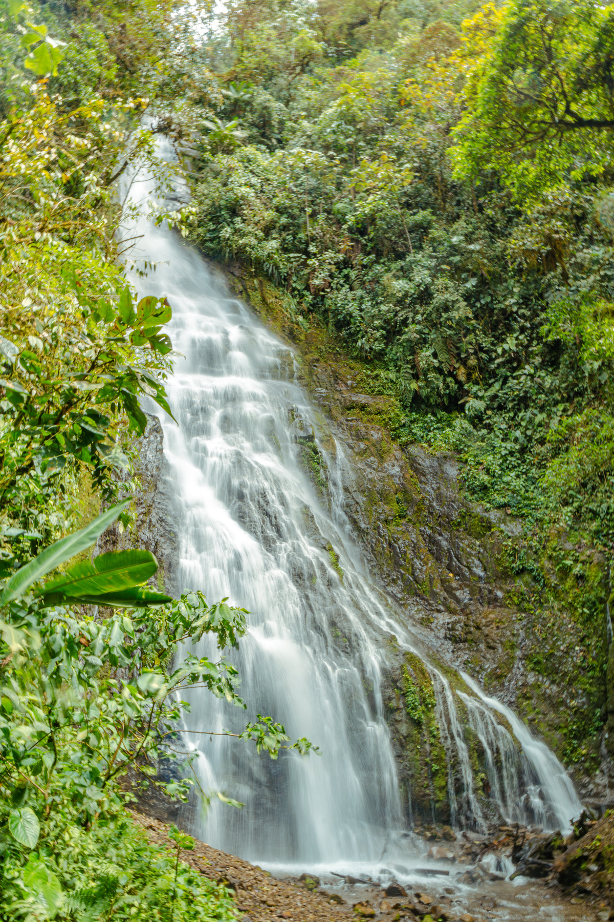
The local community participates in nature tourism and conservation initiatives
Many families in Mindo have transformed their land into private reserves, eco-lodges, and agrotourism farms that promote sustainable practices.
Community participation is also reflected in reforestation mingas, environmental education projects, and agroecological fairs that promote responsible production.

Slide 10
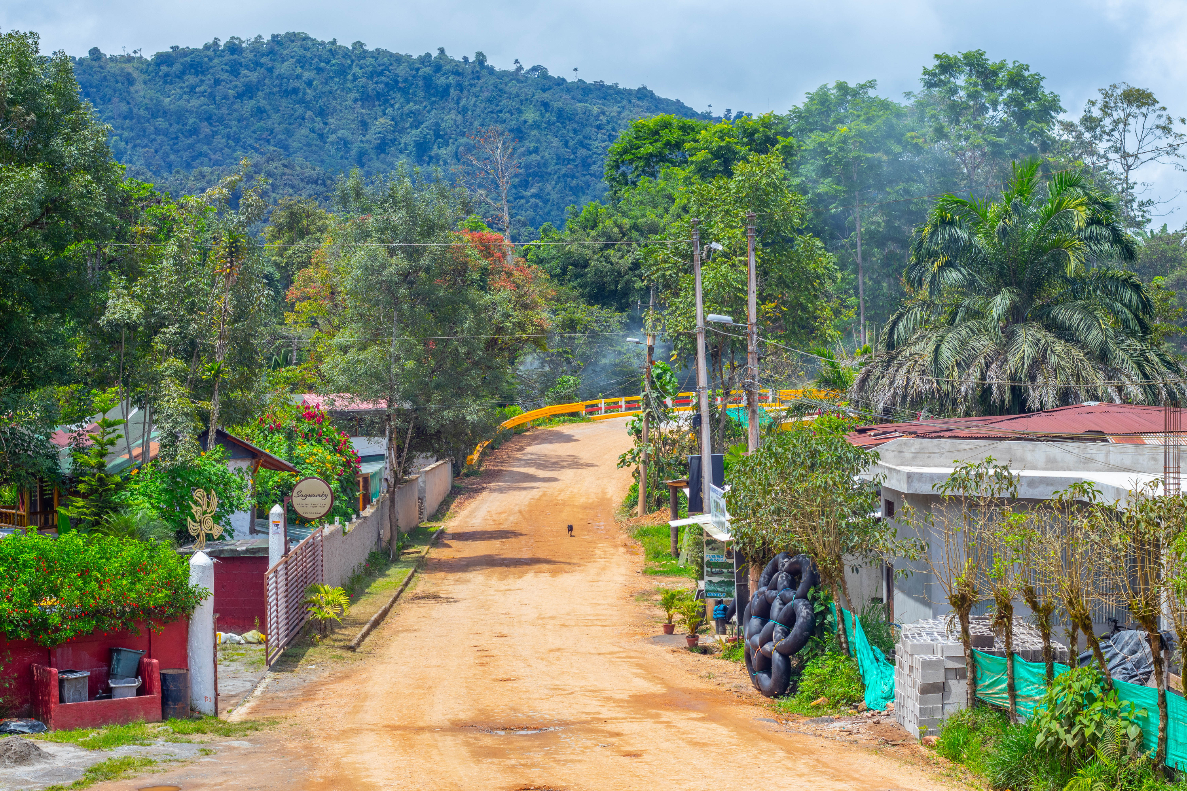
THANK YOU
““In Mindo, a bird's song not only beautifies the forest, it also sustains an economy, educates a generation, and protects an ecosystem.”

