Slide 1
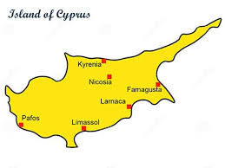
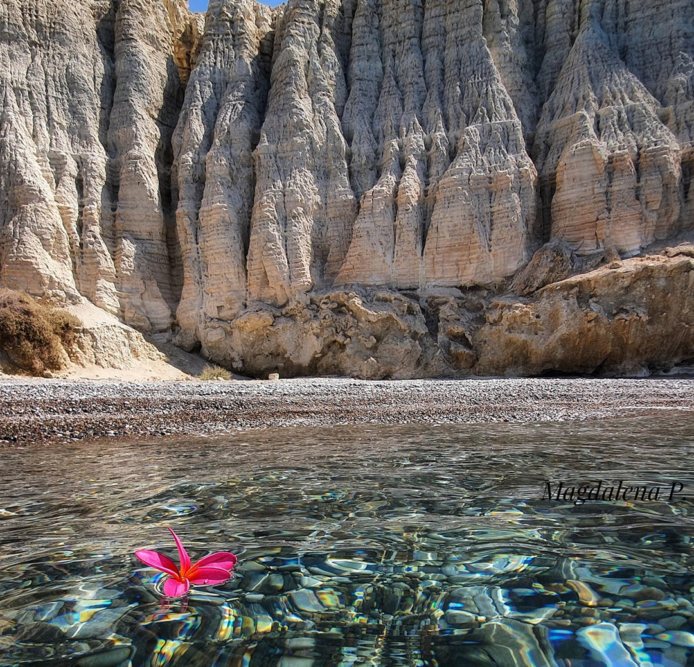

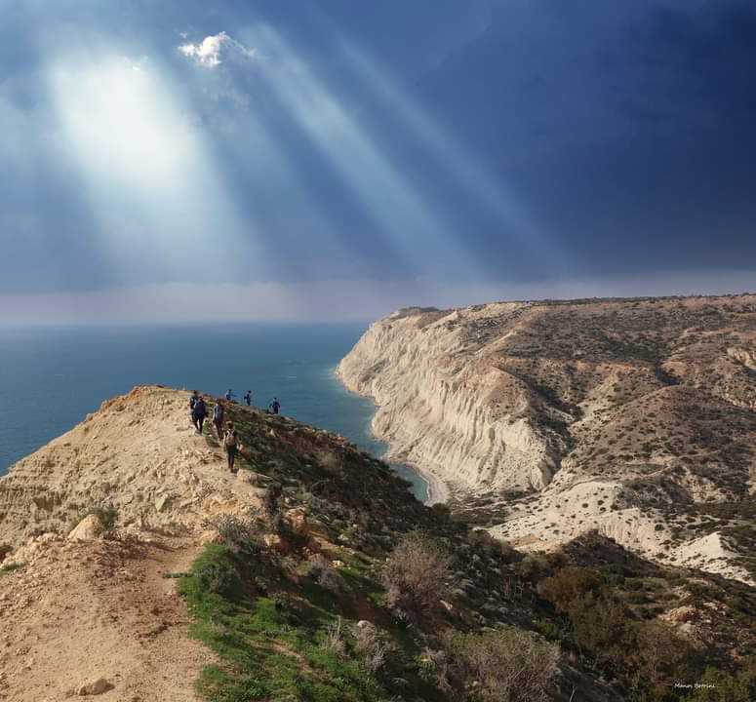
PISSOURI – CYPRUS Carol Bailey representing the Tourism Committee of Pissouri Council

Slide 2
Disclaimer
This presentation was developed by an external party to UN Tourism and was delivered during the Best Tourism Villages by UN Tourism Network Village Talks online session titled: “Tourism for Nature: Conserving Natural Resources through Sustainable Rural Development”, held on July 31, 2025.
The designations employed and the presentation of material in this publication do not imply the expression of any opinions whatsoever on the part of the Secretariat of UN Tourism concerning the legal status of any country, territory, city or area, or of its authorities or concerning the delimitation of its frontiers or boundaries.
UN Tourism does not guarantee the accuracy of the data included in this publication and accepts no responsibility for any consequence of their use.
The mention of specific companies or products of manufacturers does not imply that they are endorsed or recommended by UN Tourism in preference to others of a similar nature that are not mentioned.

Slide 3
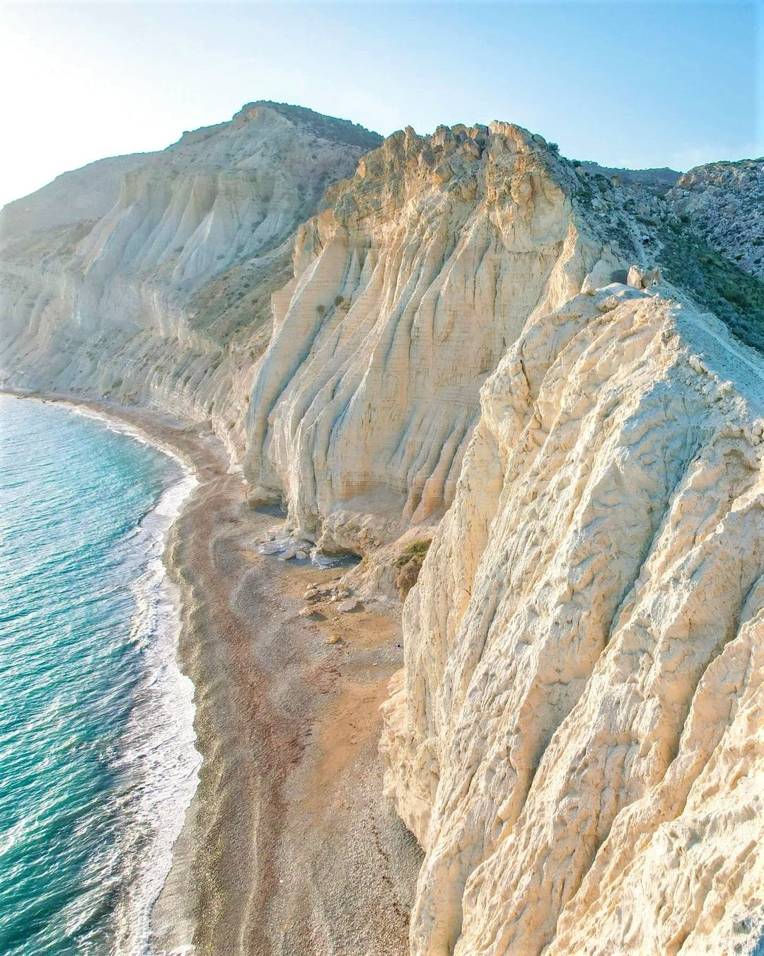
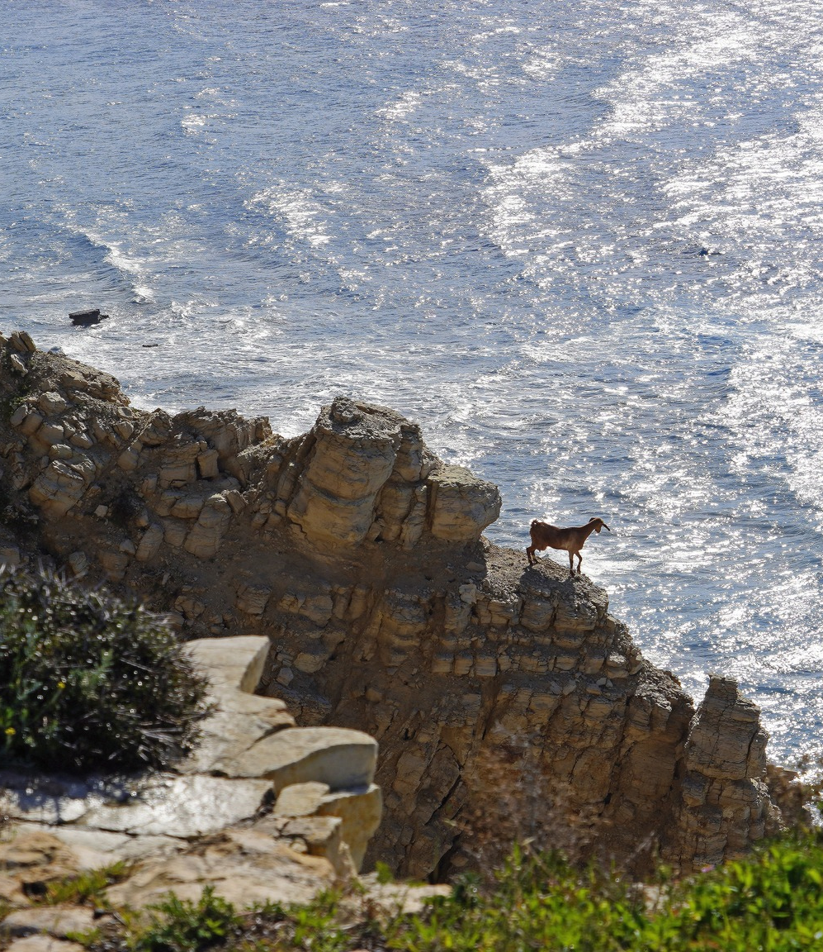

Tourism for Nature: Conserving Coastal and Marine Resources Through Sustainable Rural Development
Promoting eco-friendly tourism to support coastal ecosystems
Notes:
This presentation focuses on how sustainable rural tourism can protect and conserve coastal and marine resources. We will explore strategies, challenges, and the role tourism plays in ensuring the health of these vital ecosystems while supporting rural communities.

Slide 4
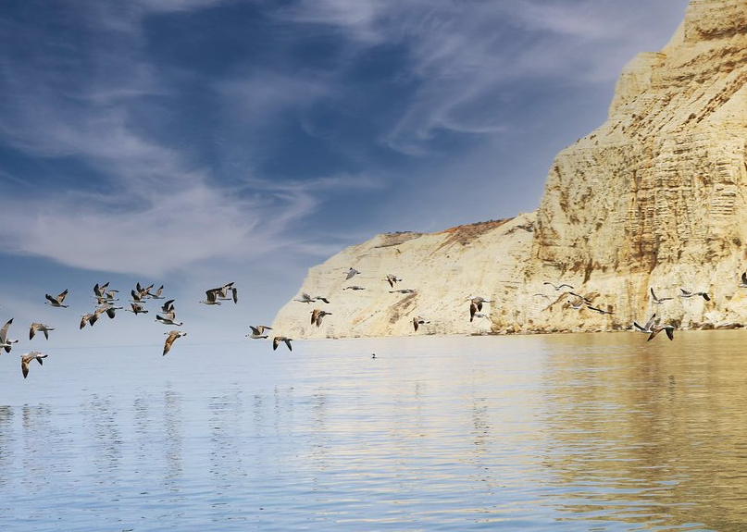
Agenda
Protecting Coastal and Marine Resources in Rural Tourism Areas
Key Sustainability Actions for Resource Conservation
The Role of Tourism in Supporting Environmental Actions
Enhancing Tourism Experience Through Conservation Efforts
Notes:
We will begin by understanding the importance of coastal and marine resources in rural tourism areas, then discuss key sustainability actions. Next, we'll look at how tourism supports environmental conservation, enhancing visitor experiences through these efforts, and finally, managing tourism impacts for long-term sustainability.

Slide 5

Protecting Coastal and Marine Resources
Notes:
Coastal and marine resources are essential for rural tourism, providing natural beauty and biodiversity. This section highlights their value, significance, and the challenges they face from increasing tourism and environmental pressures.

Slide 6
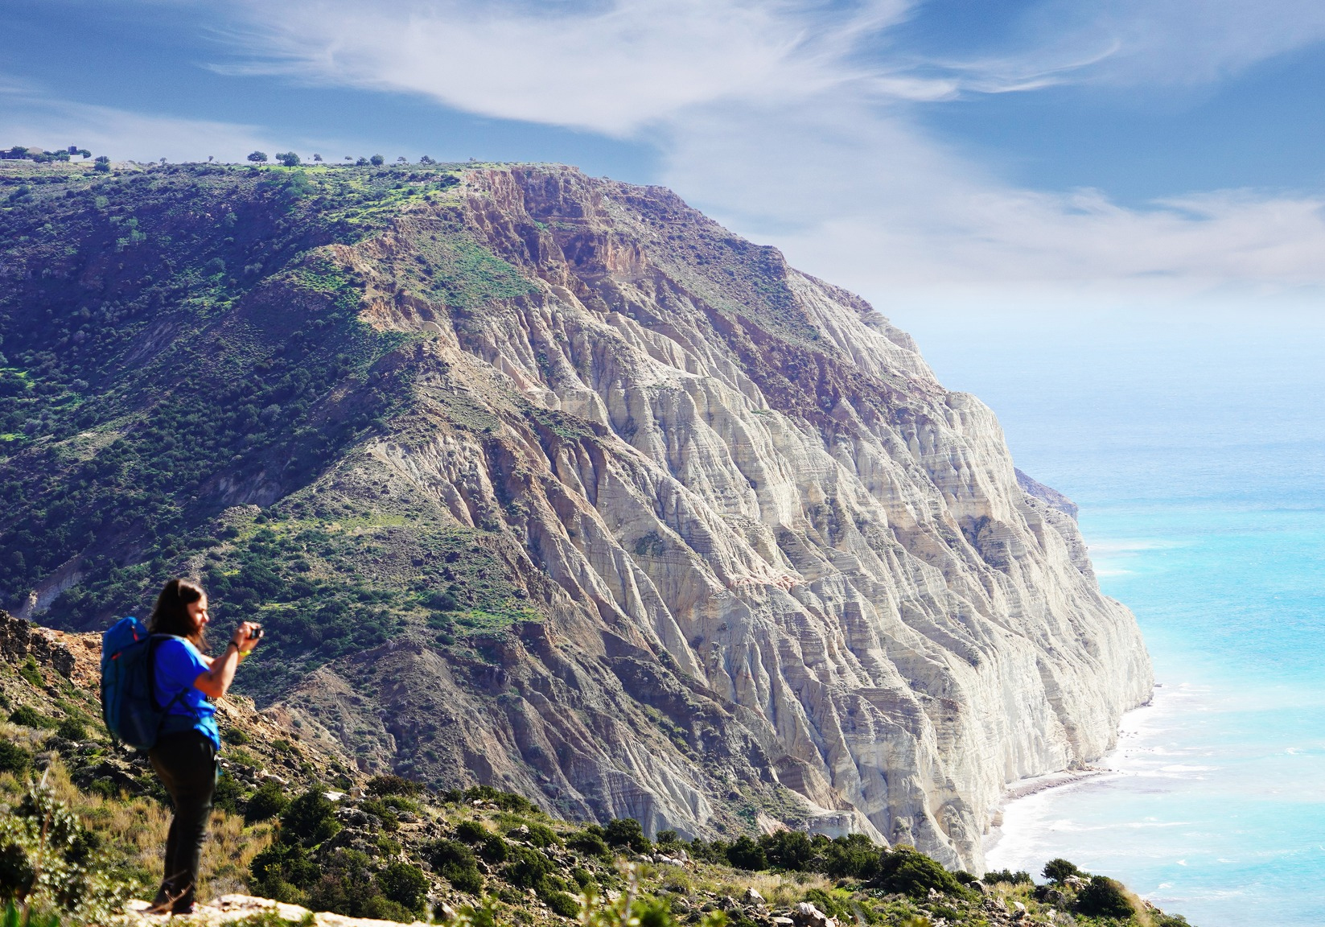
NATURA 2000 Economic Benefits
Tourism and Recreation
Natura 2000 sites attract tourists interested in nature-based activities, boosting local economies through spending on accommodation, food, transportation, and recreational activities.
Ecosystem Services
These areas provide essential services like clean water, pollination, and climate regulation, which are vital for human well-being and economic activity.
Resource Management
Sustainable management of resources within Natura 2000 sites, such as timber and agricultural products, can generate income for local communities.
Job Creation
Natura 2000 can create direct and indirect jobs in sectors like tourism, agriculture, forestry, and conservation.
Notes:
Beaches and coastal ecosystems offer recreation, habitat for wildlife, and natural protection against erosion. Their preservation is crucial for maintaining the attractiveness and ecological balance of rural tourism destinations.

Slide 7
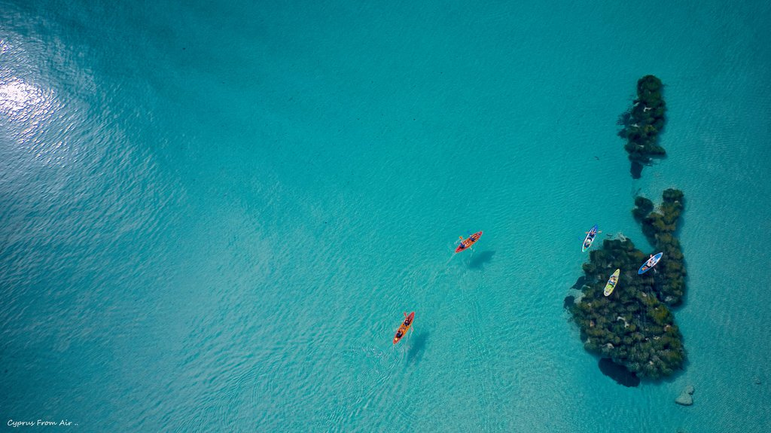
NATURA 2000 Social Benefits
Health and Well-being
Access to green spaces and natural environments has been linked to improved physical and mental health, reduced stress, and enhanced quality of life.
Sense of Place and Community
Natura 2000 sites can foster a sense of place and community identity, promoting social cohesion and civic engagement.
Cultural Heritage
Many Natura 2000 sites contain cultural and historical significance, contributing to the preservation of local heritage.
Environmental Education
These areas offer opportunities for environmental education and awareness-raising, promoting responsible stewardship of natural resources.

Slide 8
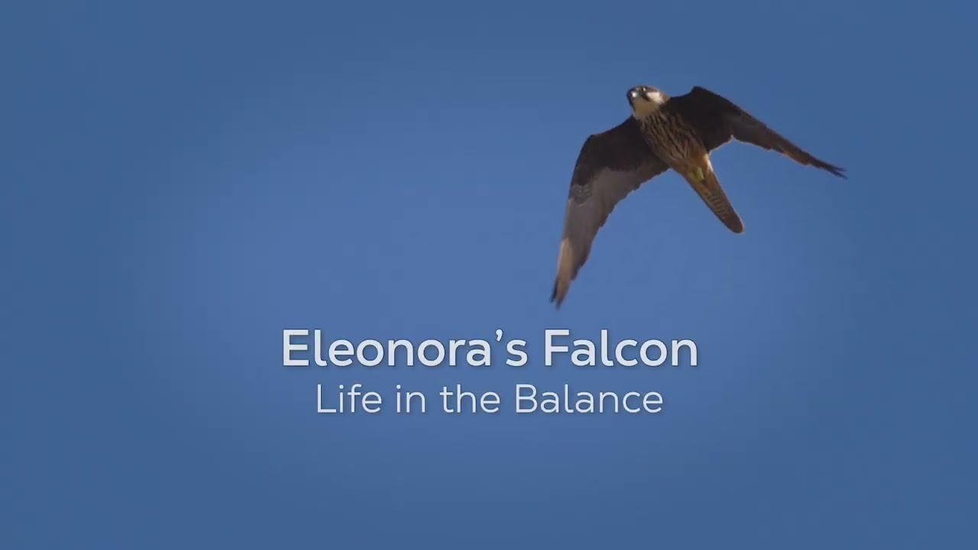
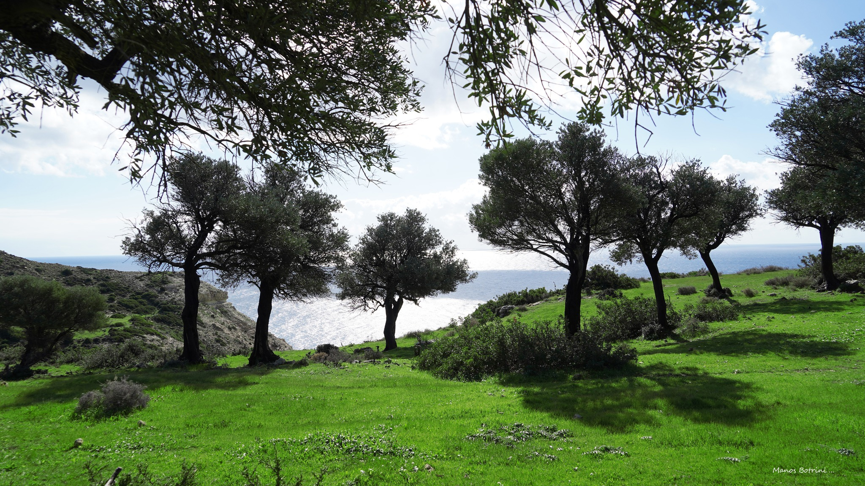
NATURA 2000 Environmental Benefits
Biodiversity Conservation
Natura 2000 sites directly contribute to the conservation of threatened species and habitats, maintaining biodiversity and ecological integrity.
Climate Change Mitigation and Adaptation
Ecosystems within Natura 2000 sites can play a role in mitigating climate change through carbon sequestration and providing natural buffers against extreme weather events.
Water Quality and Quantity
These areas can improve water quality by filtering pollutants and regulating water flow, benefiting both human populations and ecosystems.

Slide 9
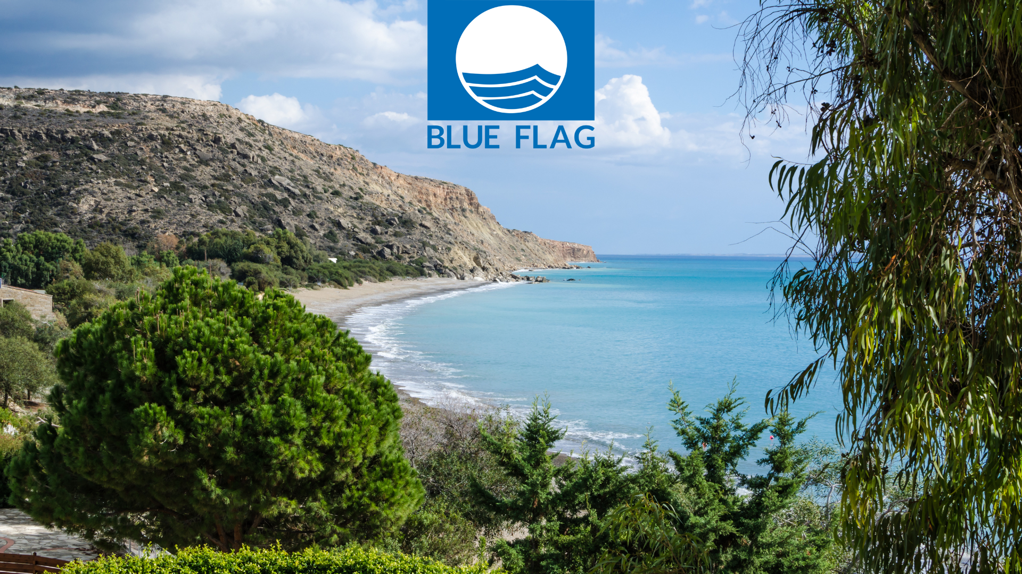
Blue Flag Initiative Key aspects
Environmental Management
Beaches must implement effective environmental management practices, including waste management, recycling programs, and promoting sustainable tourism.
Water Quality
Blue Flag beaches must have excellent water quality, meeting strict European Union standards.
Environmental Education
Beaches are required to provide information about the local ecosystem, biodiversity, and environmental issues.
Safety and Services
Beaches must have adequate safety measures, including lifeguards, first-aid facilities, and clear signage.
The Cyprus Marine Environment Protection Association (CYMEPA) is responsible for the Blue Flag campaign on the island.
Notes:
Marine biodiversity supports fisheries, tourism, and ecosystem services. Protecting diverse species and habitats ensures resilient marine environments that benefit both nature and local economies.

Slide 10
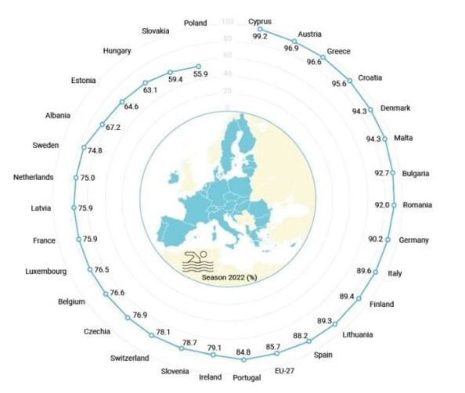
EU Water Quality
The European Environment Agency (EEA) consistently ranks Cyprus high in its annual bathing water quality assessments, with the vast majority of Cypriot beaches achieving the highest "excellent" rating. In 2024, 99.2% of Cyprus's bathing waters were rated as excellent, leading the EU.
This high standard is maintained through regular monitoring of water quality parameters, ensuring the safety and cleanliness of the beaches for both locals and tourists.
The excellent water quality contributes significantly to the island's appeal as a tourist destination, positively impacting the hotel and rental sectors.
Ref Land Cy 2025

Slide 11
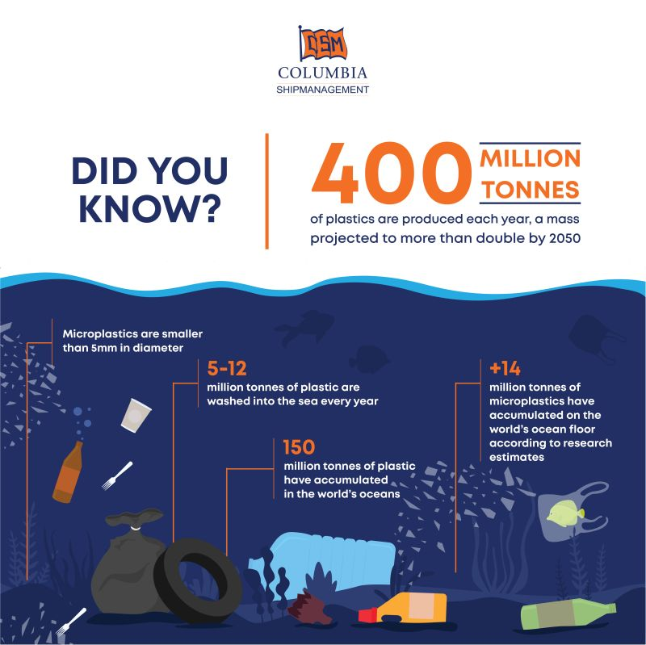
Challenges faced by Coastal & Marine Environments
Pollution Impact
Microplastics are present in Pissouri, Cyprus, and are a subject of research and cleanup efforts.
Overfishing Threat
Overfishing poses a significant threat to marine life and ecosystems in and around Pissouri, Cyprus. This includes the potential for fish stock depletion, impacts on vulnerable species, and potential harm to the local fishing industry.
Light Pollution
Development in Agricultural areas and close to the coastline has produced a negative effect on clear skies, Astro tourism and night life animals’ behavior.
Climate Change Effects
Beach Erosion
Notes:
Coastal areas face threats such as pollution, habitat destruction, overfishing, and climate change. Tourism can exacerbate these challenges if not managed sustainably, risking long-term degradation.

Slide 12
Key Sustainability Actions for Resource Conservation
Notes:
To conserve coastal and marine resources, effective sustainability actions are vital. This section presents practical measures, including certifications, infrastructure improvements, and resource management techniques.

Slide 13
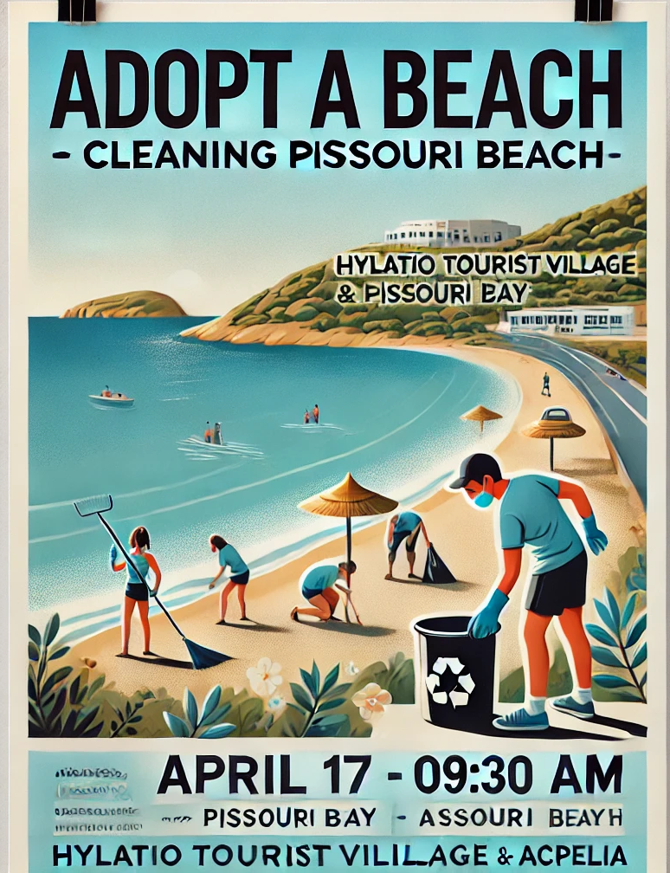
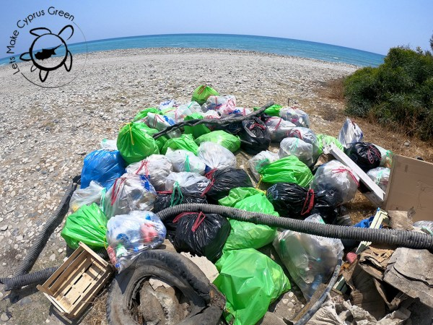
Beach Clean Ups
NGO AKTI is conducting a study to assess microplastic pollution on Cypriot beaches, including those in Pissouri.
Hylatio Tourist Village and NGO Acpelia have partnered with the reBLUE initiative to address microplastic pollution through beach cleanups and data uploading.

Slide 14
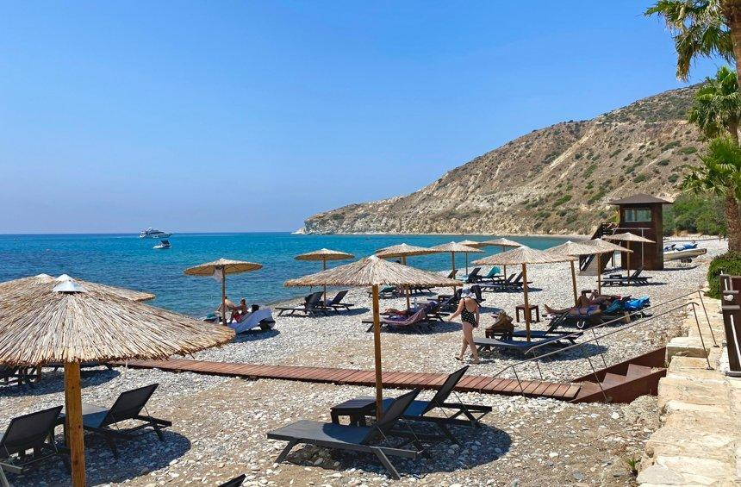
Eco-Friendly Beach Infrastructure
Minimizing Environmental Footprint
Eco-friendly infrastructure uses sustainable materials and methods to reduce impact on coastal ecosystems. Recycling program Door to door collection. Minimizing one use plastic containers and giving to business incentives for recycling.
Supporting Natural Processes
Designs that support natural coastal processes help preserve biodiversity and maintain ecosystem balance. Cyprus Breakfast initiative and Taste of Cyprus menus.
Enhancing Visitor Experience
Eco-friendly designs provide comfortable visitor amenities while preserving the natural beauty of the beach.
Notes:
Eco-friendly infrastructure minimizes environmental footprint through sustainable materials and design, supporting natural processes and enhancing visitor experience without harming ecosystems.

Slide 15
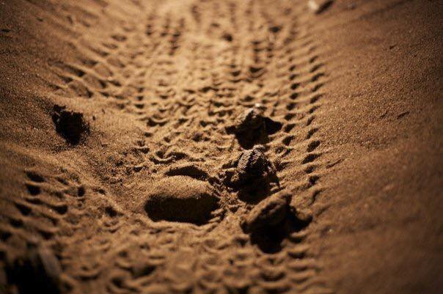
Pissouri Turtle Watch
Turtles hatch on Pissouri Beach every year, they lay their eggs in nests normally from the first week in June, with hatching from the middle of August onwards.
Turtles in Cyprus are protected under law, and the volunteers from Pissouri Turtlewatch patrol the beaches in June trying to identify and mark the nests so that they can be monitored and protected.
A 24-hour hotline is now available for those who find injured, sick, or dead sea turtles, the Oceanic Institute of the University of Cyprus has announced.

Slide 16

Recycling Programs
Pissouri Council is
running a recycling program in Cooperation with Green-Dot. Door to door collection once per week
encouraging local business to recycle by subsidising 20% of the annual garbage collection tax for businesses that prove recycling schemes.

Slide 17

Wastewater Reuse Systems
Cyprus has a high rate of treated wastewater reuse, primarily for irrigation, and the government is actively involved in the construction, operation, and maintenance of tertiary treatment plants.
Implementing wastewater reuse systems in Pissouri involves several key steps:
upgrading existing wastewater treatment plants (WWTPs) to tertiary treatment
establishing infrastructure for water storage and distribution, and implementing strict regulations for water reuse practices.
Columbia Luxury Resort: “every drop of wastewater we produce is recycled and used in our gardens or supplied to local farmers”

Slide 18
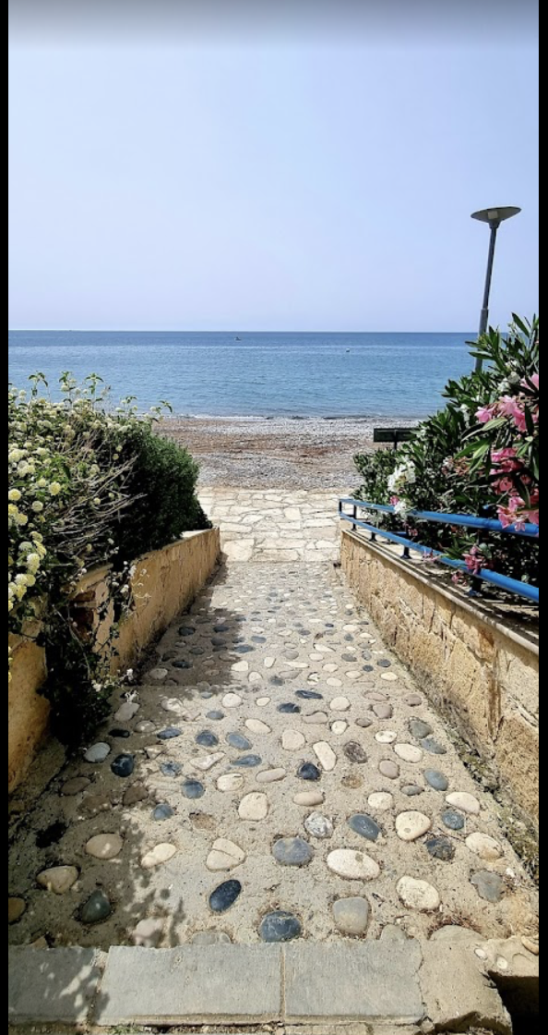
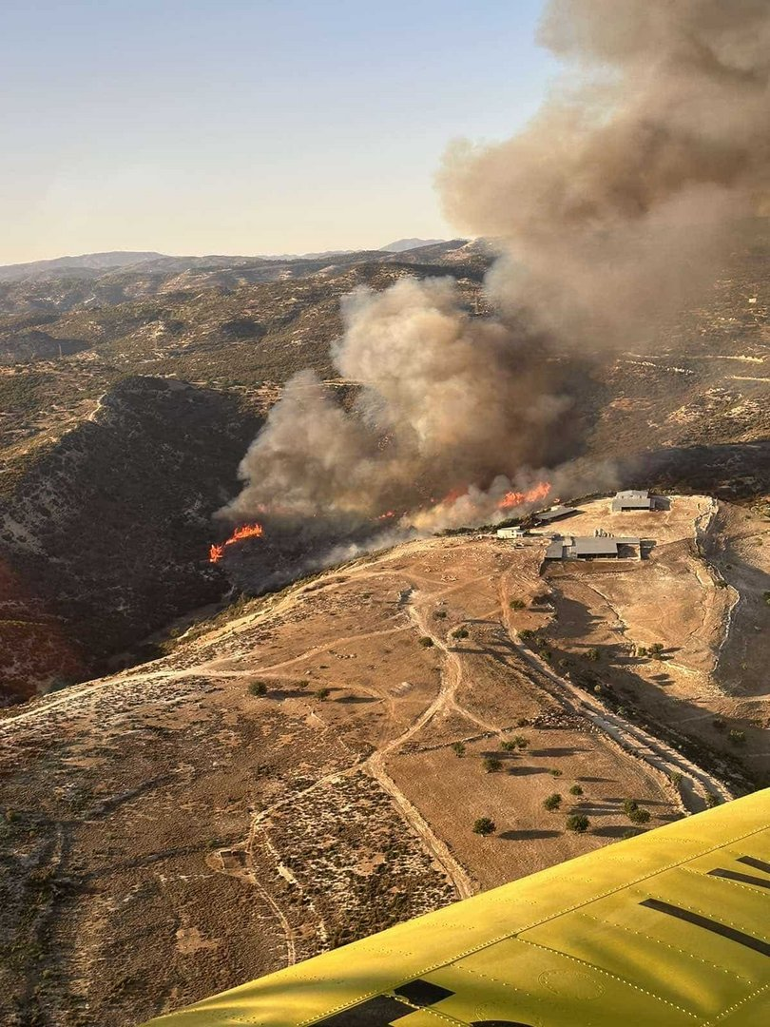
Climate Change
Evidenced through temperature increase, lack of rain, water shortages, fires, coastal erosion.
Pissouri is
mitigating coastal erosion through provision of beach facilites,, licensed activities
maintaining the pebble/sand beach and walkway
proposing environmentally friendly breakwaters/artificial reefs
reducing the risk to habitat, species, property and lives managing fire risk; removing dry vegetation alongside roads and in farmland
coordinating the local community resources and volunteers to develop and execute a. fire response plan

Slide 19
The Role of Tourism in Supporting Environmental Actions
Notes:
Tourism can be a powerful driver for conservation by providing funding, raising awareness, and engaging local communities. This section examines how tourism contributes positively to environmental protection.

Slide 20
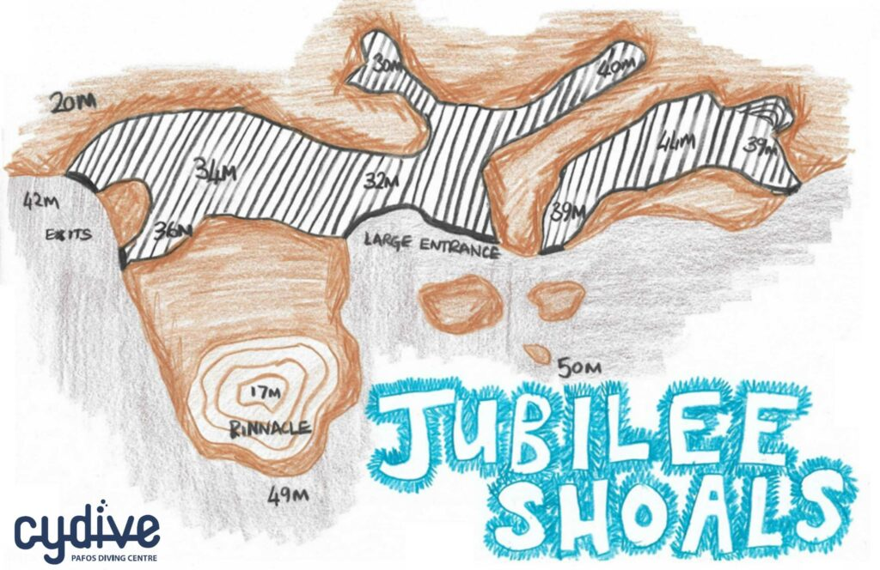
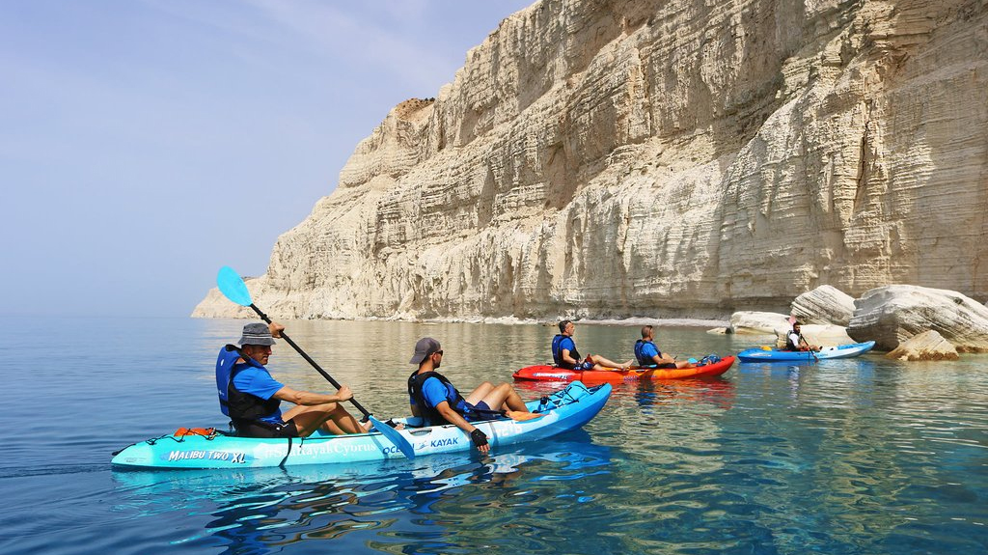
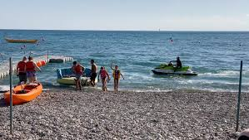
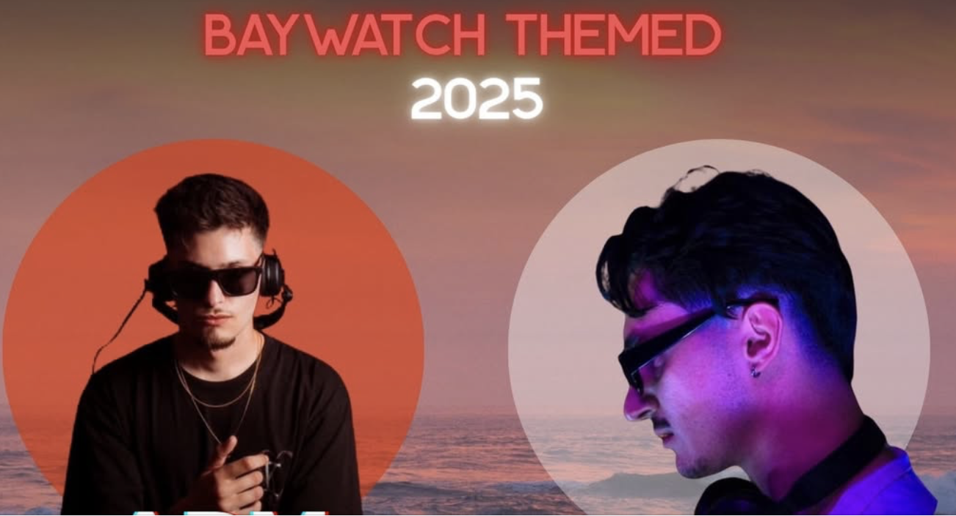
Water Sports

Slide 21
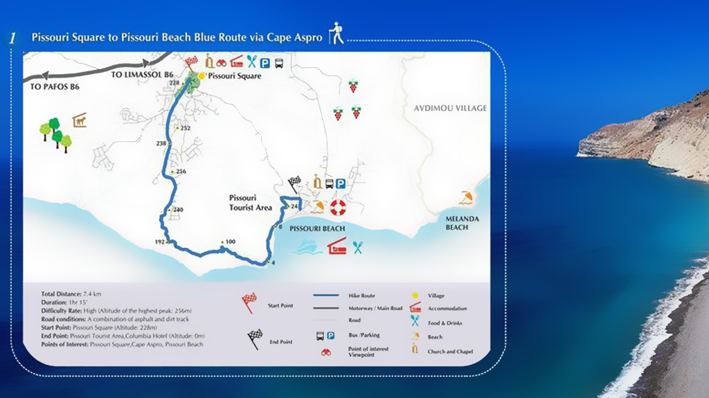
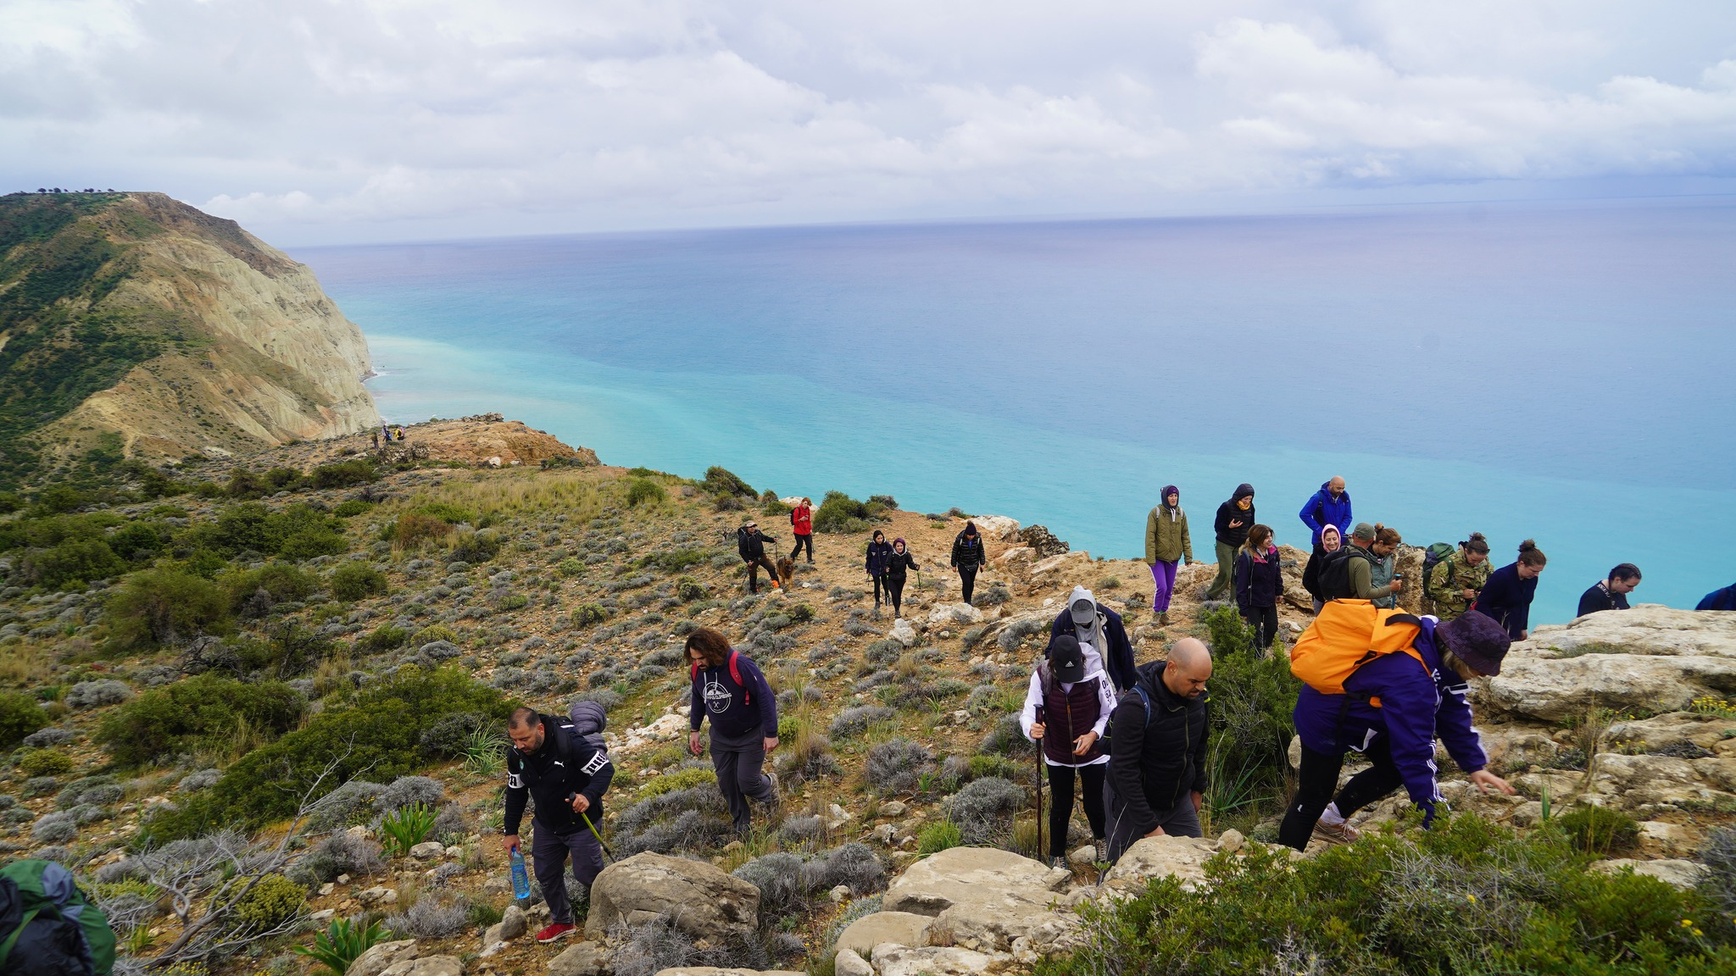
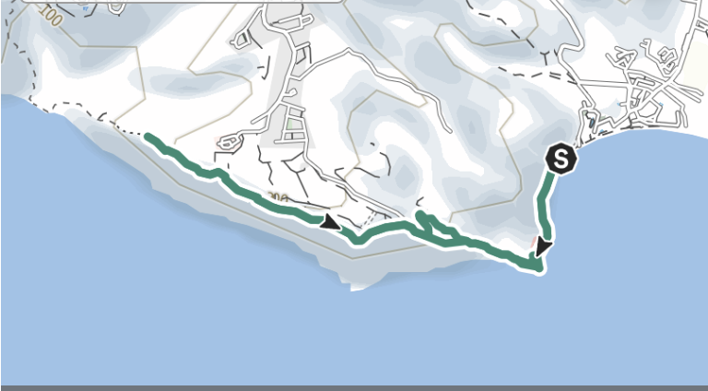
Coastal Nature Trails
Pissouri Nature Trails - The area has 8 hiking trails, crossing through the hills, providing some spectacular views and an amazing geological experience, with fossils of sea life to be found many hundreds of feet above the sea level.
Aphrodite Trail along Cape Aspro
Notes:
Sustainable destinations appeal to eco-conscious travelers who value natural beauty and responsible tourism, leading to increased visitation and support for conservation efforts.

Slide 22


Tourism Funding & Awareness for Conservation Projects
Pandoteira Pissouri event
The Pandoteira project, together with the Pissouri Local Authority, organised an event titled: “Natura 2000: Generating awareness among stakeholders”. The event took place on Saturday April 9th, 2022 and began with a hike at the Genesis Aphrodite’s Trail, followed by a presentation at the Pissouri Elementary school.
Natura 2000 Day celebration – 2024
In 2024, the Department of Environment and Terra Cypria organised a 2-day celebration for Natura 2000 Day, under the framework of the Pandoteira project. Includes activities for children and adults.
Swim Series
Annual sea swimming events for children & adults

Slide 23
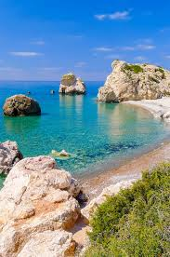

UNESCO Cultural and Natural Heritage
Cape Aspro and Aphrodite’s Rock (Petra tou Romiou) may soon be included in the UNESCO World Heritage list.
To be recognized as a World Heritage site, an area must have outstanding universal value and meet at least one of the ten criteria established by the International World Heritage Convention, which include archaeological, cultural, biological, and geological factors.
Cape Aspro has immense ecological value, while Aphrodite’s Rock holds geological and archaeological significance.
Environment Commissioner has suggested a joint effort by the communities of Pissouri and Kouklia for the wider area between the two communities, which includes Cape Aspro and Petra tou Romiou, to be included on the UNESCO Cultural and Natural Heritage List.

Slide 24

Engagement of Local Communities
Supporting Local Livelihoods
Engaging local communities in tourism creates economic opportunities and supports sustainable livelihoods.
Respecting Cultural Values
Incorporating and honouring local cultural traditions fosters respect and authentic tourist experiences.
Natural Resource Stewardship
Local involvement encourages responsible management and protection of natural resources for sustainability.

Slide 25
Enhancing Tourism Experience Through Conservation Efforts
Notes:
Conservation efforts not only protect nature but also enhance the quality of the tourism experience. This section explores how environmental preservation attracts visitors and builds destination reputation.

Slide 26
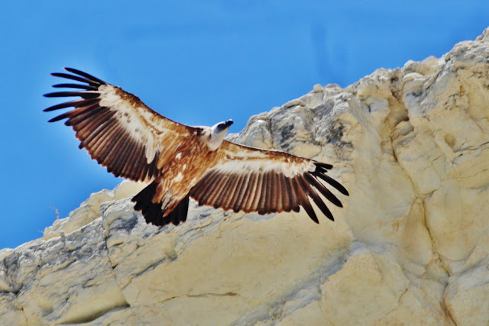

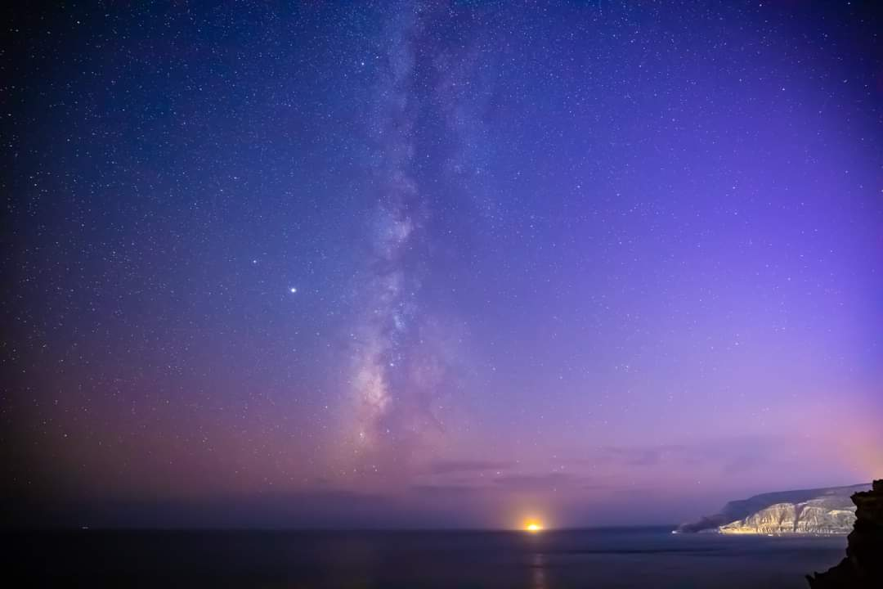
Attracting Environmentally Conscious Tourists
Birdwatching
Star gazing on Pissouri beach
Re-introduced Griffin Vultures
Pissouri night sky

Slide 27
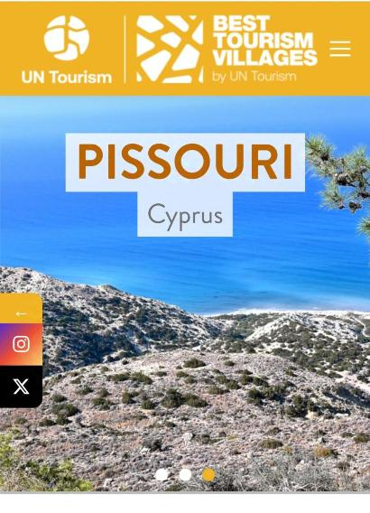

Building a Reputation for Sustainability
Green communities Awards
Best Tourist Villages 2024

Slide 28




Acpelia Sustainable Tourism Programs
Notes:
Involving local people ensures that tourism supports livelihoods, respects cultural values, and fosters stewardship of natural resources, creating sustainable benefits for all stakeholders.

Slide 29

PISSOURI - CYPRUS
Conclusion
Sustainable Tourism Benefits
Sustainable rural tourism helps conserve coastal and marine ecosystems while promoting local economic growth.
Responsible Practices
Adopting responsible tourism practices minimizes environmental impact and preserves natural resources.
Community Engagement
Involving local stakeholders ensures sustainable development and stewardship of precious environments.
Pissouri is committed to Sustainable Tourism development,
for the wellbeing of the local and visiting communities, our heritage and natural environment.
Notes:
Sustainable rural tourism offers a pathway to conserve coastal and marine resources while supporting local development. By adopting responsible practices and engaging stakeholders, we can ensure these precious environments thrive for future generations.

